Slide 1
Community Development Block Grant from Infrastructure Finance Authority/Oregon Business Development Department
Completed with lending services and client support provided by:

Slide 3
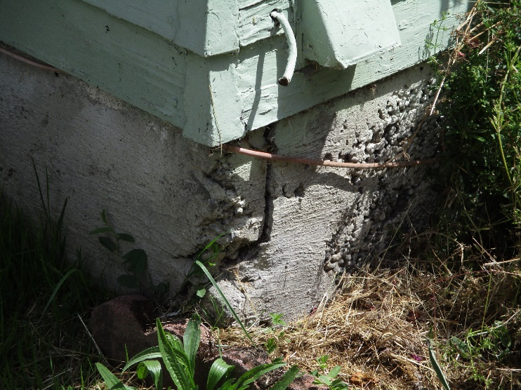
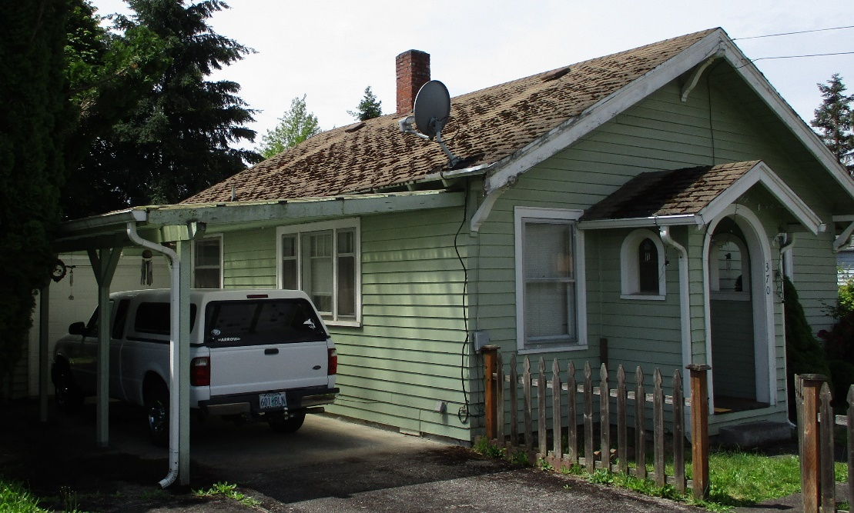
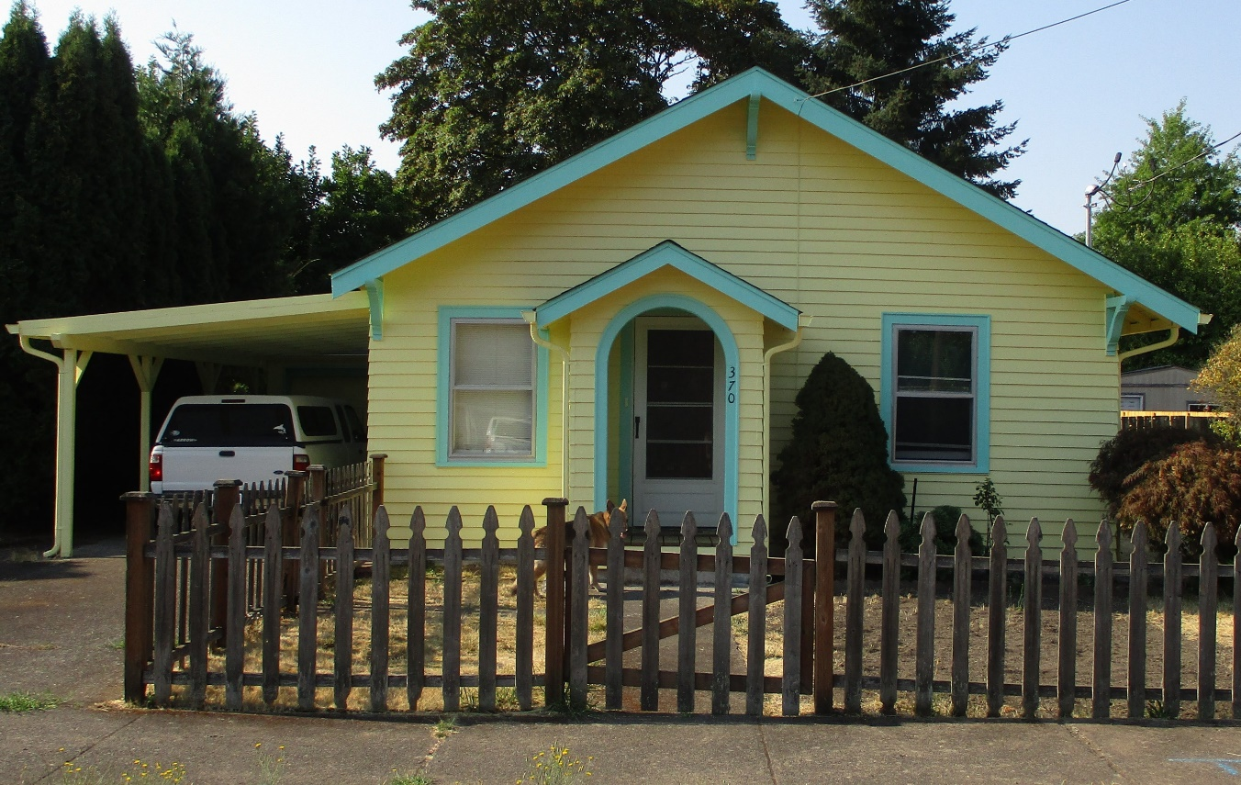
Removed and replaced roofing, insulated walls, replaced some siding, new gutters, fixed dry rot, fixed foundation, replaced water service line and electrical fixes.

Slide 4
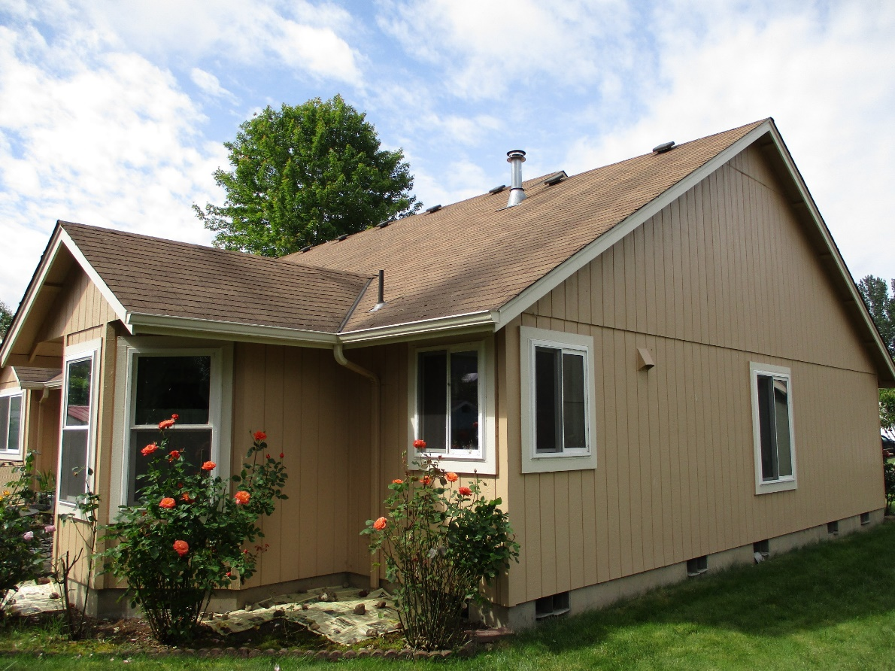
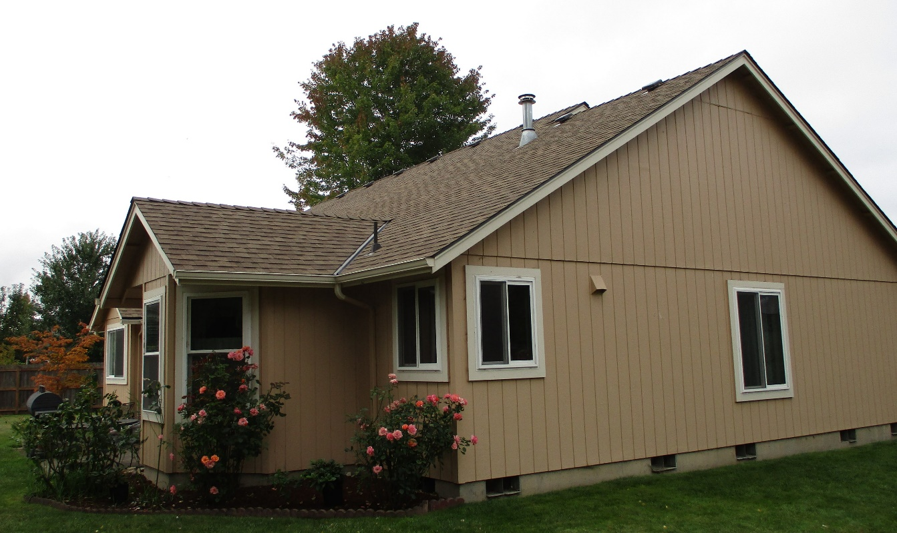
A new roof, water heater, and repairs to dry rotted siding.

Slide 5
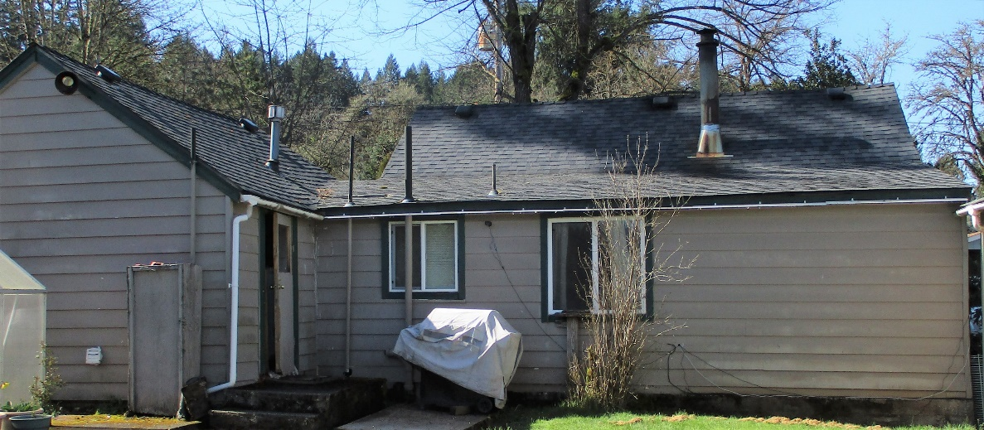
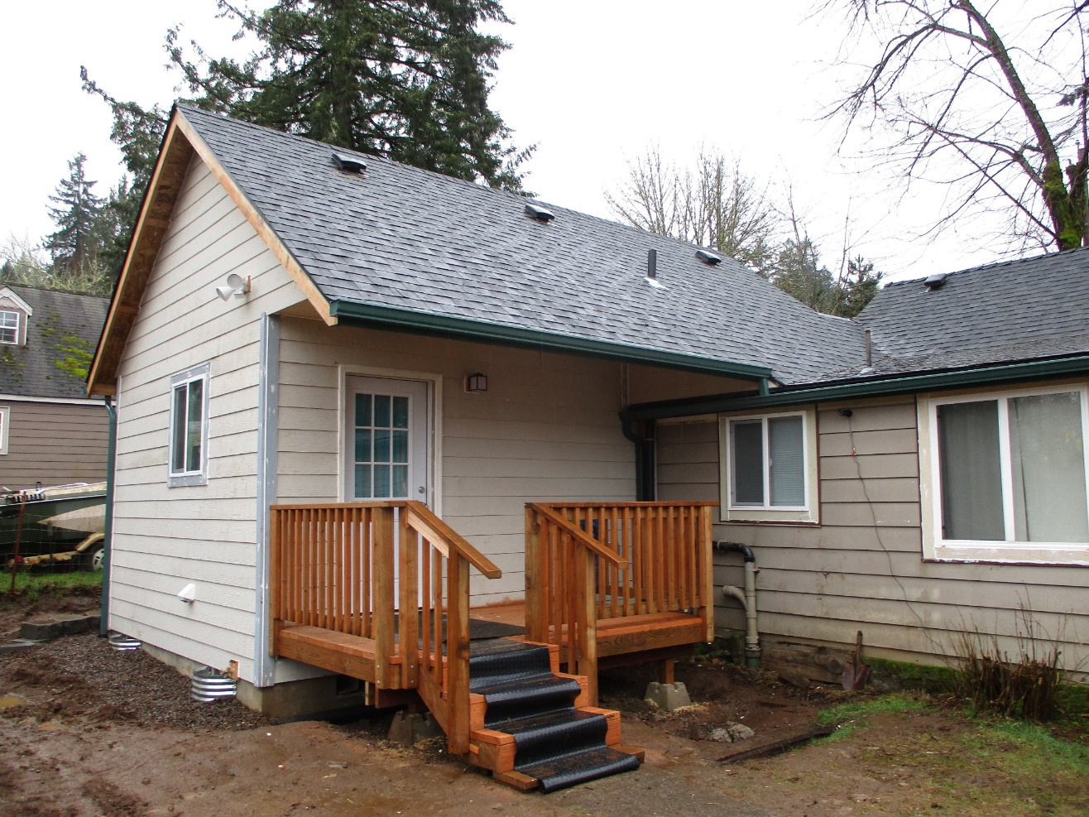
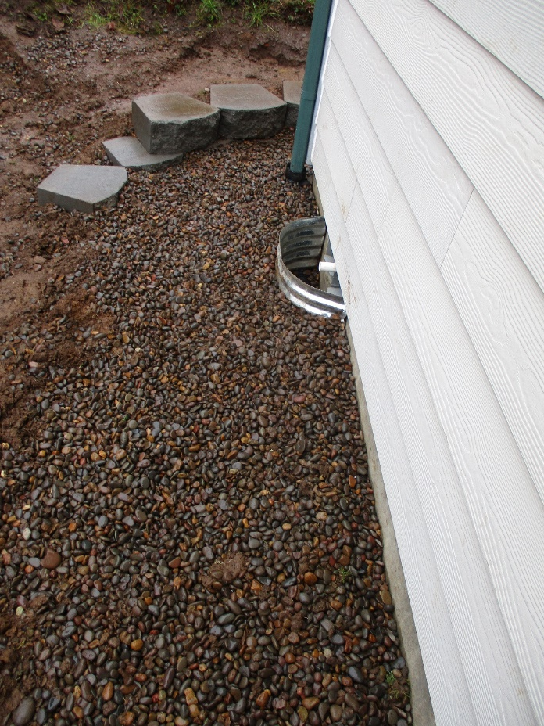
A poorly constructed and foundationless addition to the house was sinking. We had to tear it down completely and rebuild it. We added a French drain on the uphill side of the addition, and installed a dry well.
Notes:
.

Slide 6
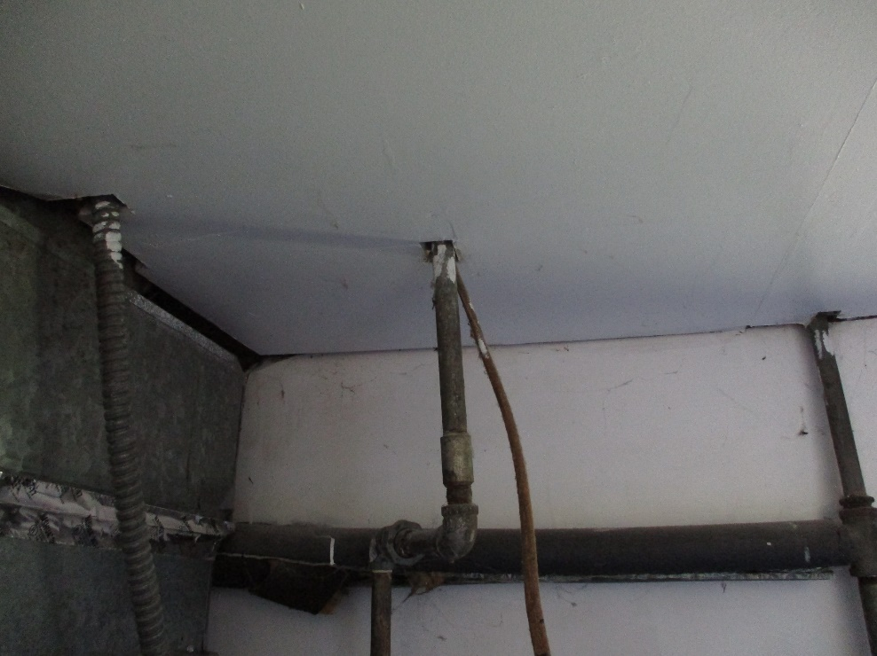
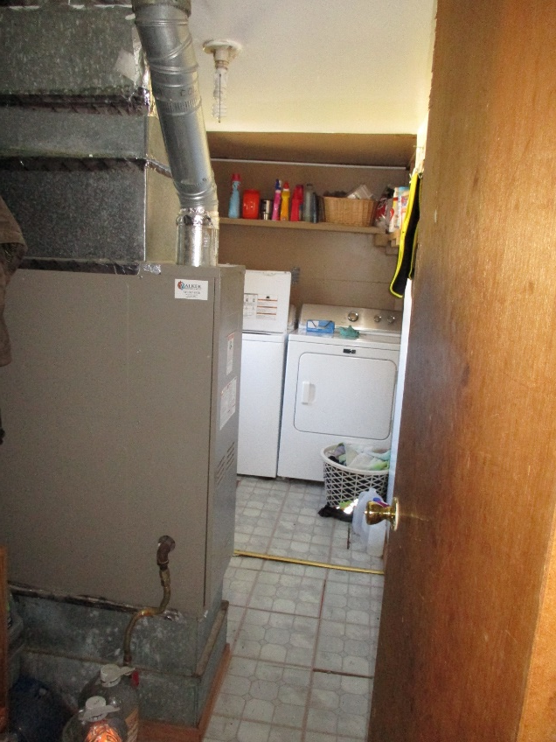
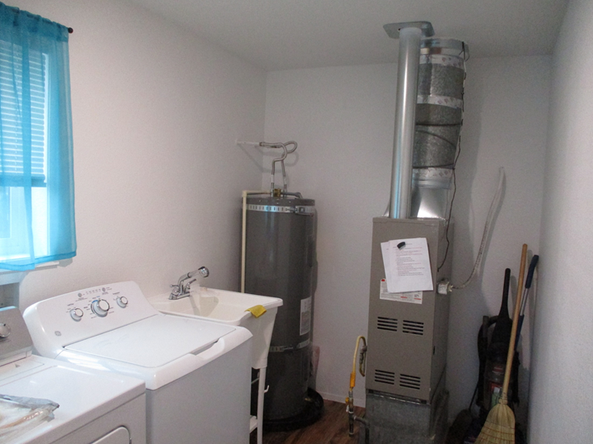
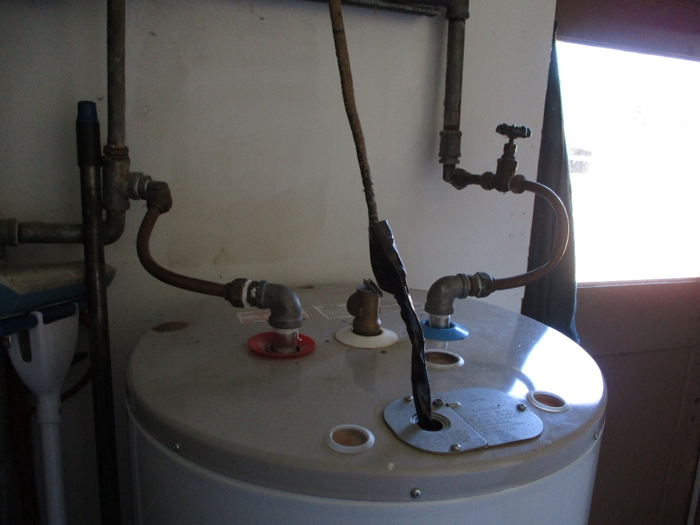
In the process of rebuilding the addition, we replaced the furnace and water heater – bringing them all up to code.

Slide 7
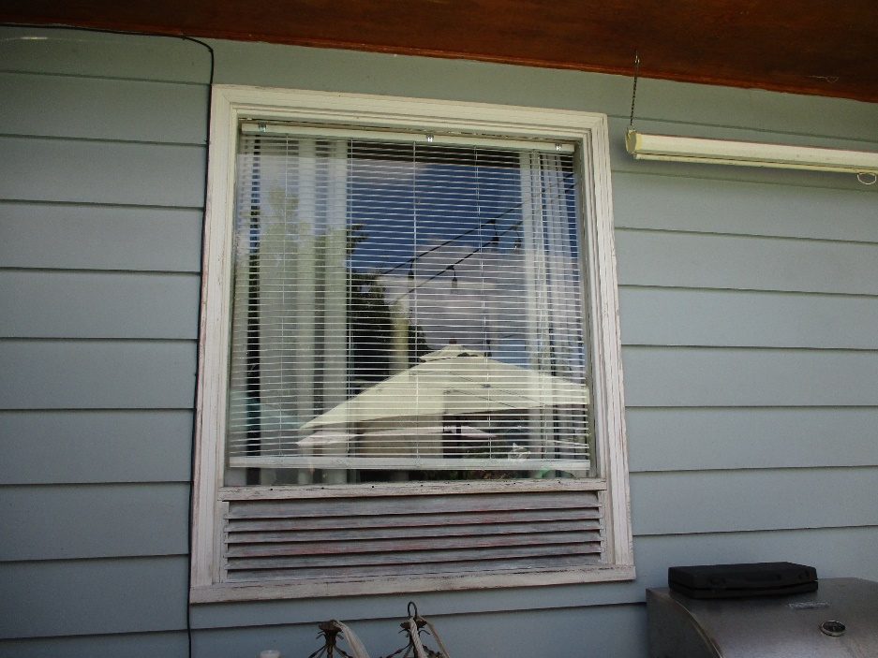
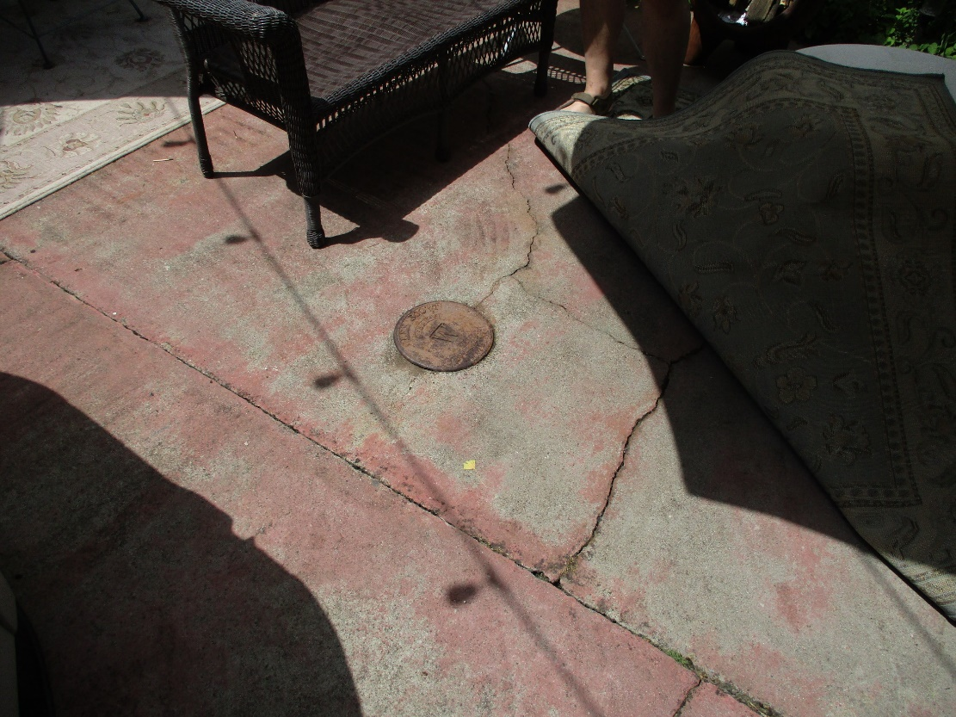
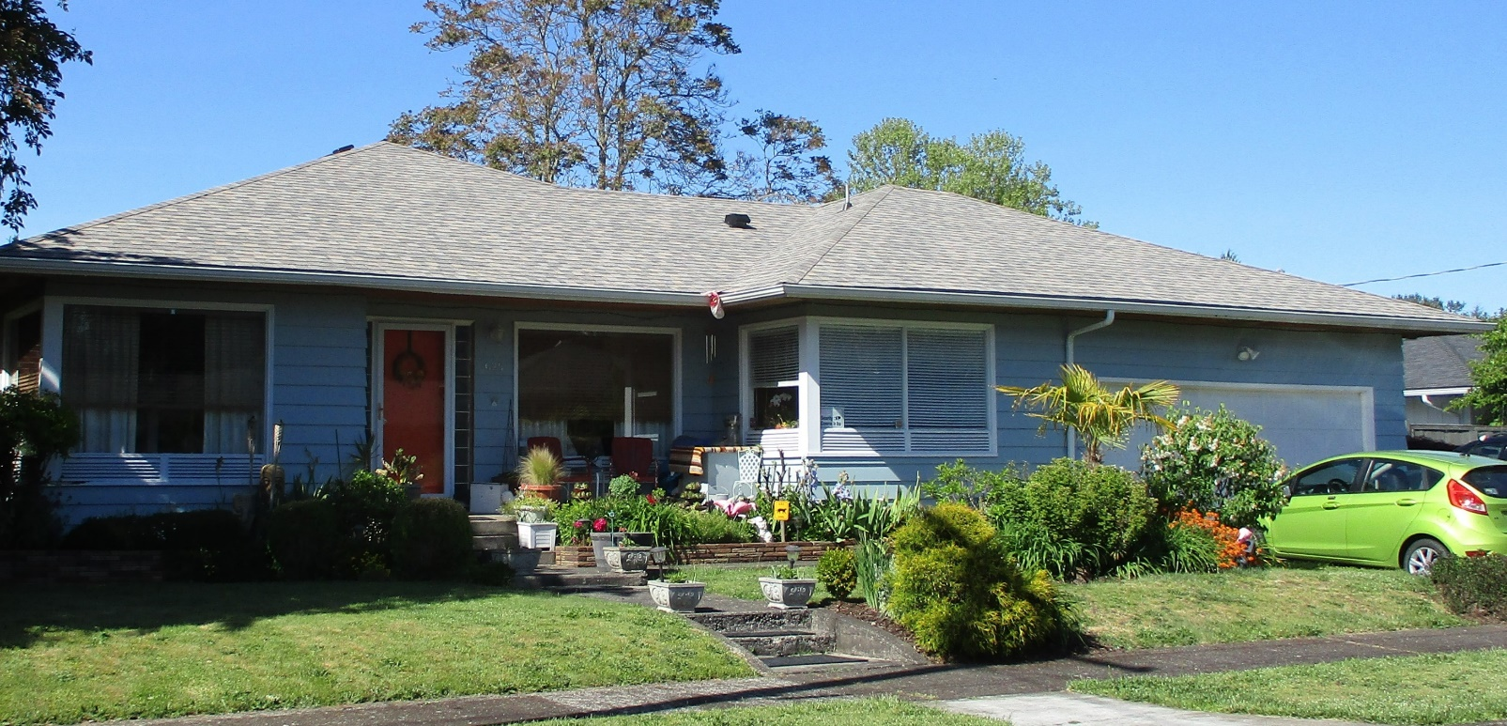
At this home we decommissioned an old underground oil tank, replaced the roof and windows and added a door for safe egress from a bedroom with un-openable windows.

Slide 8
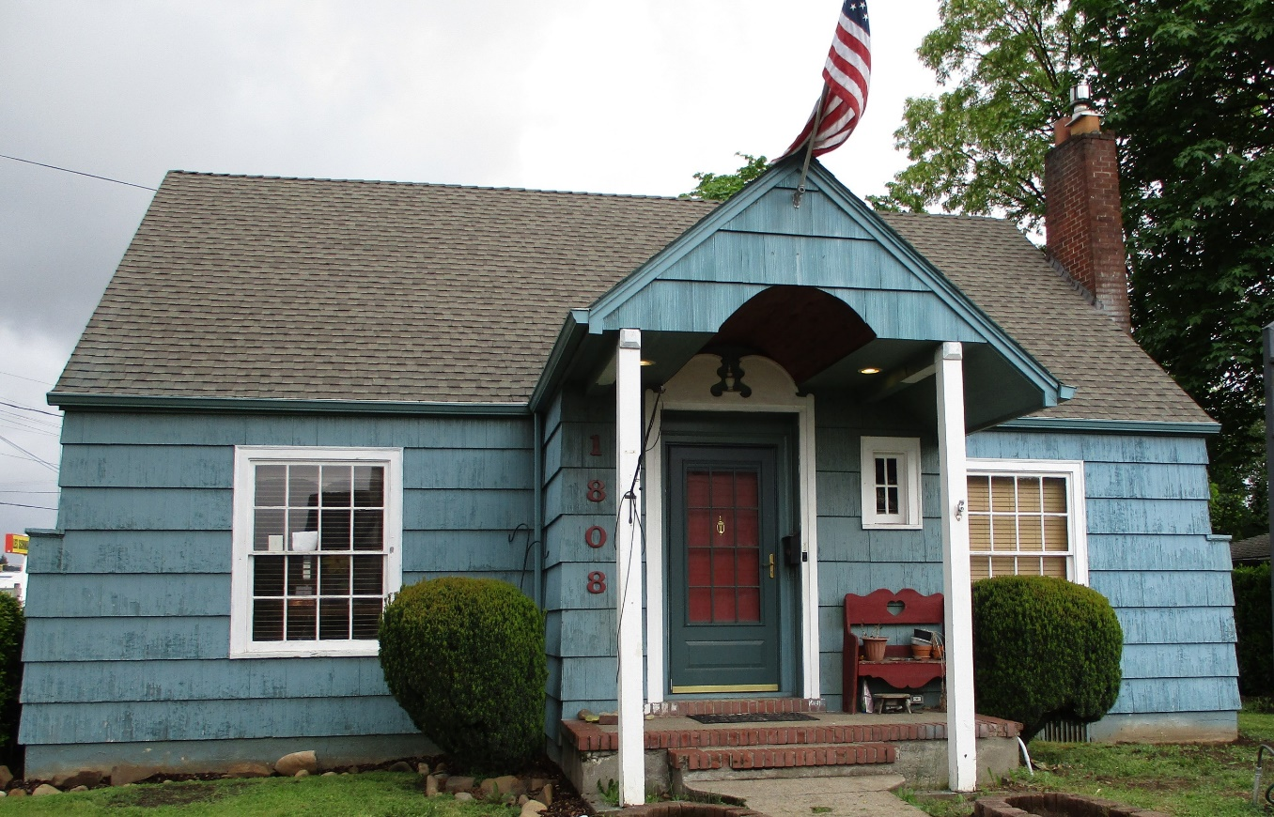
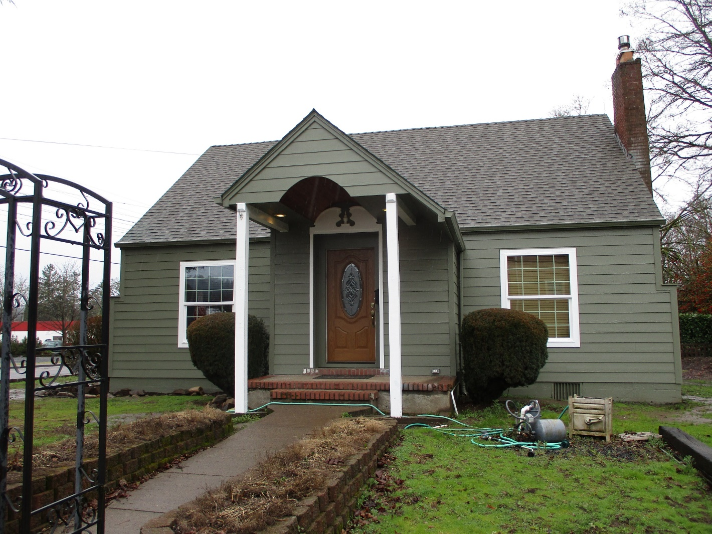
New siding, doors, and windows, chimney repair, and exterior paint.

Slide 9
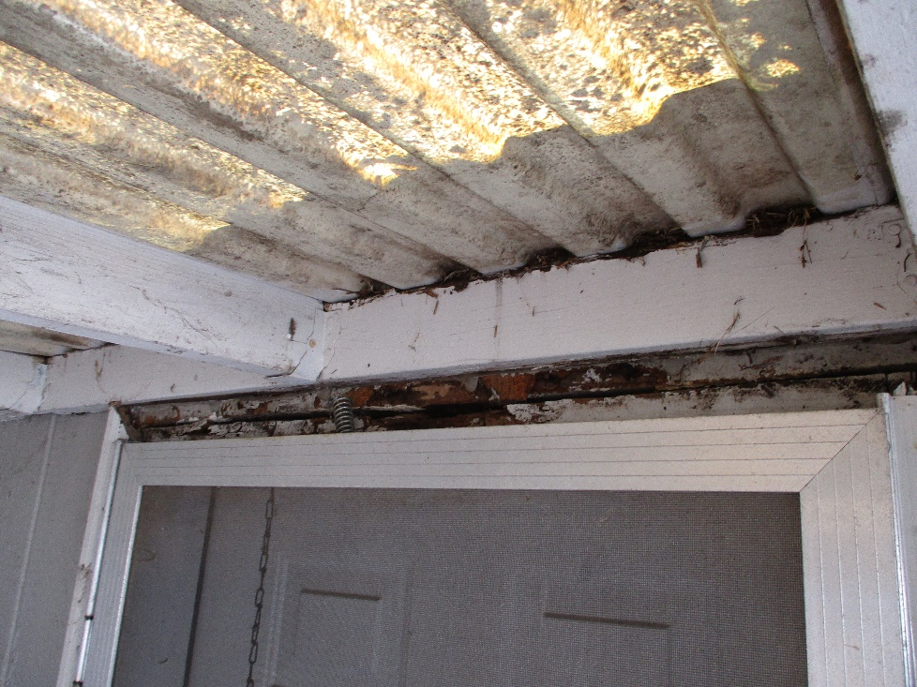
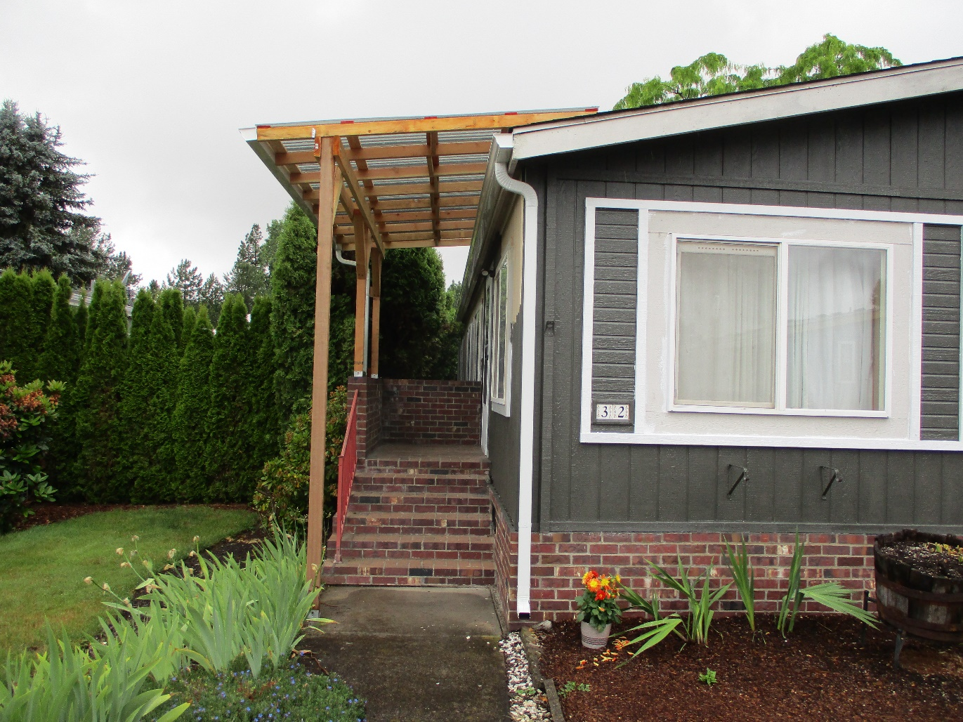
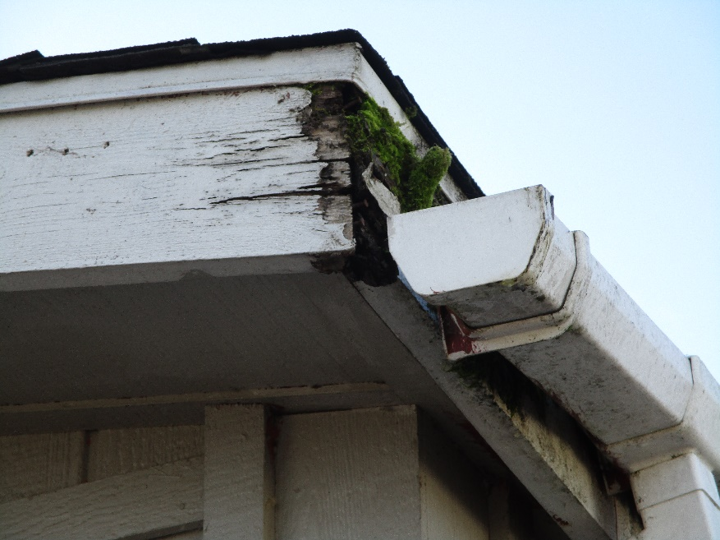
Our first grant to a homeowner in a manufactured home park. We replaced the roof and gutters, repaired siding, and rebuilt the entry covers. The homeowners were so inspired that they painted the exterior themselves!

Slide 10
Overall, we provided support and funding for 5 homeowners
in Sweet Home, 9 homeowners in Lebanon (7 of whom were
grant recipients for the homes in parks program),
3 homeowners in Tangent (2 using the homes in parks grants),
and 1 homeowner in Waterloo.

