Slide 1
COVID-19 Training Requirements
Module 1: Introduction

Slide 2
DISCLAIMER
This material is used to inform employers of compliance requirements from Oregon OSHA standards, through simplification of the regulations. It should not be considered a substitute for any provisions of the Oregon Safe Employment Act or for any standards issued by Oregon OSHA.
This course is intended to meet 4 of the 10 training requirements as outlined in OAR 437-001-0744 Addressing COVID-19 Workplace Risks (3)(i). In addition, the last module of this course includes information regarding other items in the list of required training elements.
Please note that this material is based on the latest information provided by the Oregon Health Authority (OHA) and the Centers for Disease Control and Prevention (CDC). As more information is discovered about COVID-19, we will update this course to reflect those changes.
Module 1: introduction

Slide 3
What is COVID-19?
COVID-19 is an illness caused by a virus that can spread from person to person. It currently is a public health crisis throughout the country and the world, as well as the State of Oregon. On March 23rd, 2020, Oregon Governor Kate Brown declared a State of Emergency in response to the pandemic. To date, there are over 70,000 documented cases of COVID-19 in Oregon. For clarity and ease of reference, this course refers to “COVID-19” when describing exposures or potential exposures to SARS-CoV-2, the virus that causes Coronavirus Disease 2019.
Module 1: introduction

Slide 4
Module 1: introduction

Slide 5
Employer Responsibility
First and foremost, employers do need to understand that, even in unusual times like this, employees are still exposed to hazards, and it is still the employers’ responsibility to ensure that their employees are adequately protected from those hazards. This expectation does not change.
Module 1: introduction

Slide 6
COVID-19 Temporary Standard
To help reduce worker exposure to COVID-19, Oregon OSHA was asked to develop a rule addressing this public health emergency in the workplace, called the “Addressing COVID-19 Workplace Risks”. Since this is a temporary rule, it will remain in effect until May 4, 2021, unless it is repealed before that date.
Module 1: introduction

Slide 7
Training Requirements
An important aspect of this temporary rule is the requirement for employers to train their employees on certain topics. This course is designed to satisfy 4 of the 10 training elements required by the rule. These 4 elements are:
Characteristics and methods of transmission of the SARS-CoV-2 virus;
Symptoms of the COVID-19 disease;
The ability of pre-symptomatic and asymptomatic COVID-19 persons to transmit the SARS-CoV-2 virus; and
Safe and healthy work practices and control measures.
We’ll be covering each of these elements in detail as you advance through the modules. In the final module, we’ll provide an overview of the other requirements found in the rule.
Module 1: introduction

Slide 8
COVID-19 Training Requirements
Module 2: Signs, Symptoms, and Transmission

Slide 9
Introduction
Welcome to module 2! This section covers important information about the signs, symptoms, and transmission of COVID-19. Like other diseases, COVID-19 is contagious and will spread rapidly if control measures are not established. Over the next few minutes, we’ll talk about what happens when someone contracts COVID-19 and how it spreads to others. Let’s get started!
Module 2: signs, symptoms, and transmission

Slide 10
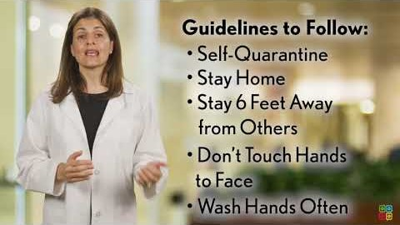
Module 2: signs, symptoms, and transmission

Slide 11
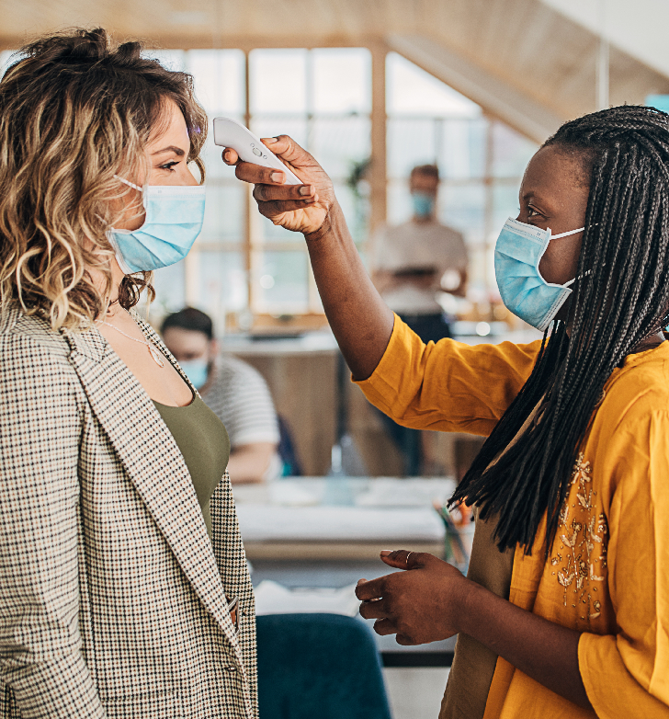
Symptoms
COVID-19 affects people in different ways. Infected people have had a wide range of symptoms reported – from mild symptoms to severe illness. Most people infected with COVID-19 will experience mild to moderate respiratory illness and recover without requiring special treatment. Older people and those with underlying medical conditions such as cardiovascular disease, diabetes, chronic respiratory disease, and cancer are more likely to develop serious illness. People of all ages who experience fever and/or cough associated with difficulty breathing or shortness of breath, chest pain or pressure, or loss of speech or movement should seek medical care immediately.
Module 2: signs, symptoms, and transmission

Slide 12
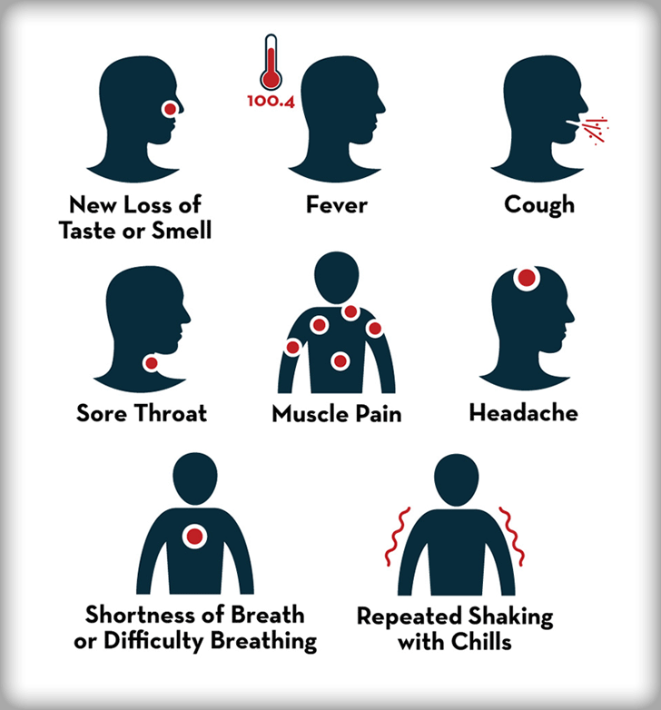
List of Symptoms
Symptoms may appear 2-14 days after exposure to the virus. People with these symptoms may have COVID-19:
Fever or chills
Cough
Shortness of breath or difficulty breathing
Fatigue
Muscle or body aches
Headache
New loss of taste or smell
Sore throat
Congestion or runny nose
Nausea or vomiting
Diarrhea
Module 2: signs, symptoms, and transmission

Slide 13
Spreading COVID-19
It is believed that COVID-19 spreads through the droplets and airborne particles that are formed when a person who has COVID-19 coughs, sneezes, sings, talks, and breathes. There is growing evidence that droplets and airborne particles can remain suspended in the air and be breathed in by others, and travel distances beyond 6 feet. Droplets can also land on surfaces and objects, and be transferred by touch. For example, a person may get COVID-19 by touching a surface or object that has the virus on it and then touching their own mouth, nose, or eyes. In the next slide, we’ll watch a video explaining how viruses spread, focusing on contaminated surfaces. Please keep in mind that the following video shows workers not wearing masks or face coverings, this is an incorrect depiction (more info is covered in module 3.)
Module 2: signs, symptoms, and transmission

Slide 14
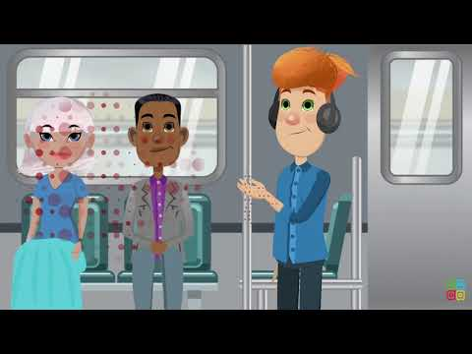
Module 2: signs, symptoms, and transmission

Slide 15
Asymptomatic and Pre-symptomatic
Both terms refer to infected people who do not have symptoms. The difference is that asymptomatic refers to those who are infected but never develop any symptoms, while pre-symptomatic refers to infected people who have not yet developed symptoms but go on to develop symptoms later. You may have heard the term "viral shedding" used in reference to the infectiousness of COVID-19. It occurs when a virus is released from an infected host. This means that both asymptomatic and pre-symptomatic individuals, who may not yet be experiencing any of the viral symptoms, are shedding viral particles while they talk, exhale, eat, and perform other normal daily activities.
Module 2: signs, symptoms, and transmission

Slide 16
Module 2: signs, symptoms, and transmission

Slide 17
Respiratory Droplets and Aerosols
As we discussed earlier, the virus can spread from an infected person’s mouth or nose in small liquid particles when they cough, sneeze, speak, sing, or breathe heavily. These liquid particles are of different sizes, ranging from larger “respiratory droplets” to smaller “aerosols”.
A respiratory droplet is a small aqueous droplet produced by exhalation, consisting of saliva or mucus. Unlike regular aerosols, droplets have a size of 5 to 10 micrometers, and the primary way COVID-19 is transmitted involves either direct or indirect contact with persons infected with COVID-19.
By comparison to droplets, aerosolized particles are infinitesimal. Size alone is not the only important distinction: Droplets fall to earth quickly, but aerosols can travel on air currents potentially for hours. This is why proper ventilation is very important, among other control measures.
Module 2: signs, symptoms, and transmission

Slide 18
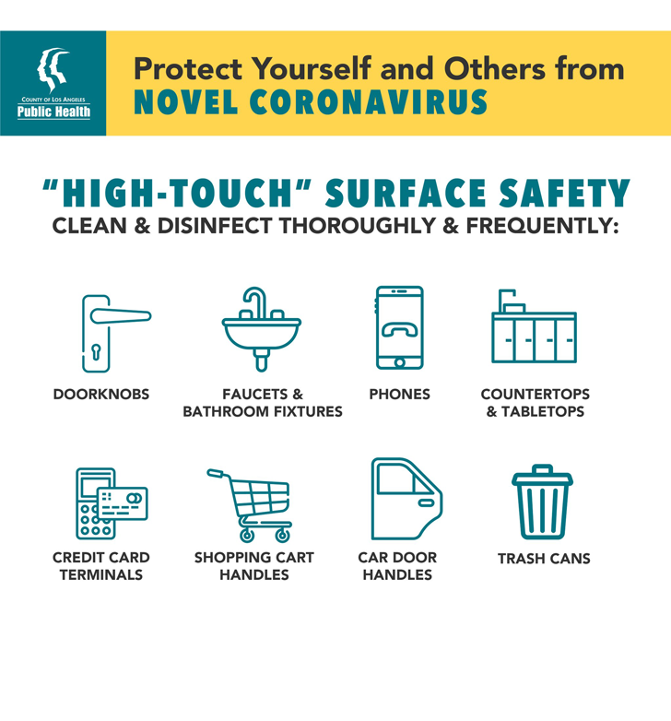
Surface Contamination
Some research shows that COVID-19 can stay alive on some surfaces for up to a few days if left unsanitized. To reduce the spread of COVID-19, it is imperative to properly sanitize and disinfect all high-touch surfaces and require employees to wash their hands before touching their face. High-touch areas are equipment or surfaces that are handled frequently throughout the day by multiple individuals. A few examples include countertops, credit card terminals, doorknobs, digital kiosks, touch-screen enabled devices, light switches, handrails, elevator control panels, and steering wheels. Please refer to the CDC guidance for more information.
Module 2: signs, symptoms, and transmission

Slide 19
Infected Employee
If an employee tests positive for COVID-19, they must follow state and local public health authority guidance for quarantine. Employers are required to allow quarantined employees to work from home if it’s feasible for them to do so. Another aspect to consider is that the employer must follow Oregon OSHA requirements for notifying other exposed and affected employees. More information is available on the Oregon OSHA website.
Module 2: signs, symptoms, and transmission

Slide 20
Overview
You’ve completed module 2! COVID-19 is a highly contagious disease that is spreading rapidly through surface contamination, droplets, and airborne transmission. People who are infected with COVID-19 may not show symptoms and unknowingly spread it to others who can become seriously ill. In the next module, we’ll look at some control measures to help you stay protected and healthy!
Module 2: signs, symptoms, and transmission

Slide 21
COVID-19 Training Requirements
Module 3: Control Measures

Slide 22
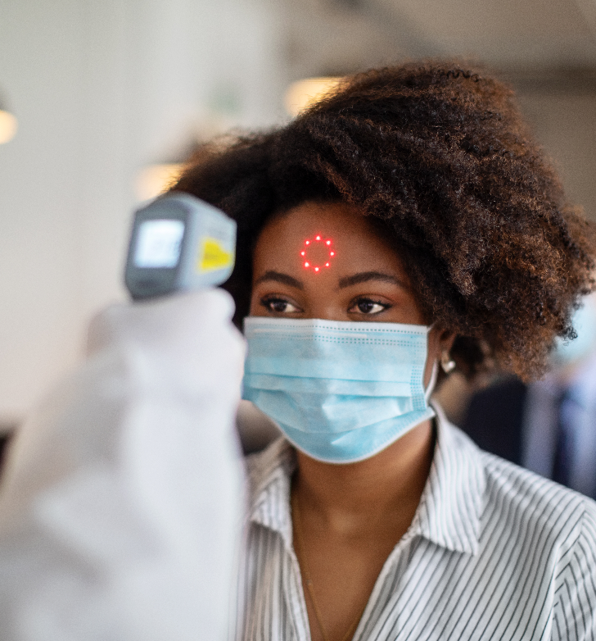
Control Measures
Welcome to module 3! This section addresses safe and healthy work practices to reduce COVID-19 hazards that workers face. Common examples include physical distancing, masks, cleaning, and proper ventilation. For these safe work practices to be effective, you and your employer must work together to implement these elements at your workplace and in all job functions. Each workplace is unique and must be evaluated as such. Let’s begin!
Module 3: control measures

Slide 23
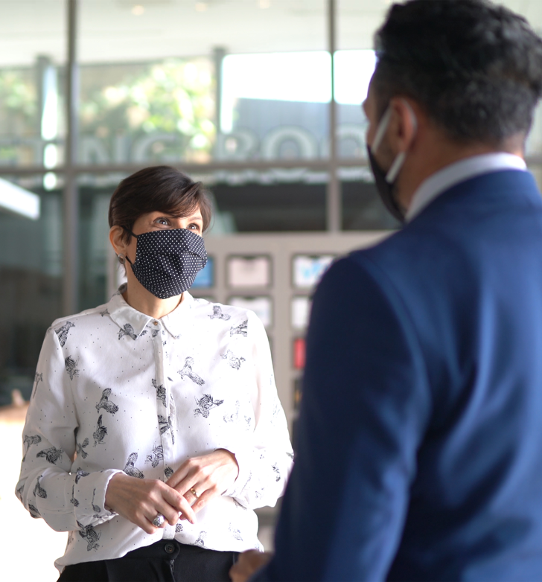
Infection Prevention
As we dive into this content on reducing the risk of exposure to COVID-19, it’s important to explain the concept of infection prevention, which is based on standard precautions. The idea behind it is that you treat everyone as if they are infected and contagious, even if they are feeling well. This is especially important because people can spread the virus without showing any symptoms or even knowing that they are sick. These are asymptomatic and pre-symptomatic cases that can be dangerous as the carriers may relax their precautions and unknowingly spread the virus to others.
Module 3: control measures

Slide 24
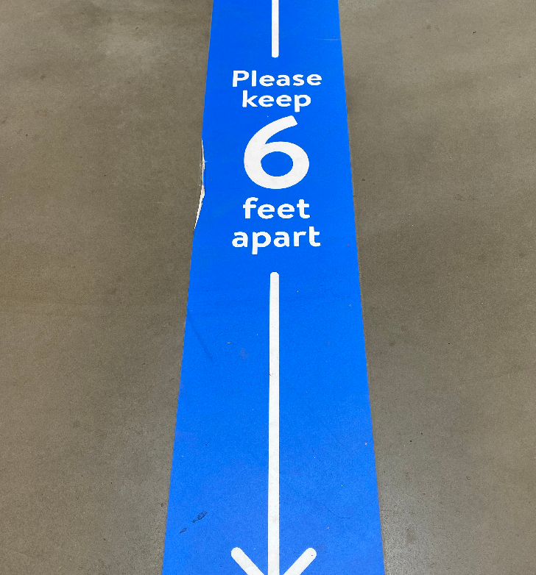
What is Physical Distancing?
Physical distancing means keeping a safe space of at least 6 feet between yourself and other people who are not from your household. This is important because COVID-19 can spread among people near each other, so staying 6 feet away from others is considered to be a good distance to reduce the spread. Your employer is required to ensure that both work activities and workflows are designed to keep employees at least 6 feet from other people, unless they can demonstrate that such physical distancing is not feasible for certain activities.
Module 3: control measures

Slide 25
Physical Distancing Requirements
Here are some examples of modifying a workplace to meet physical distancing requirements:
Modify seats, furniture, workstations, etc. to maintain at least 6 feet of separation;
Stagger shifts, start times, and break times where possible to reduce the number of team members in common areas;
Provide visual cues (e.g. signs, tape marks, floor markings) to ensure proper spacing of 6 feet in areas where team members congregate (e.g., health screening stations, time clocks, breakrooms, etc.);
Install physical barriers in areas where 6 feet of separation cannot be maintained, and
Use videoconferencing and/or teleconferencing to avoid “in-person” meetings where possible.
Module 3: control measures

Slide 26
Source Control
Source control is a strategy for reducing disease transmission by blocking respiratory droplets produced through speaking, coughing, or sneezing. Masks and face coverings are effective at source control because they act as barriers to block infectious droplets from spreading to others nearby. When someone coughs or sneezes without a barrier, they can spread airborne droplets up to 26 feet (8 meters), while someone speaking can spread droplets up to 6.6 feet (2 meters). This is why wearing a mask or face covering is very important to reduce the spread of COVID-19.
Module 3: control measures

Slide 27
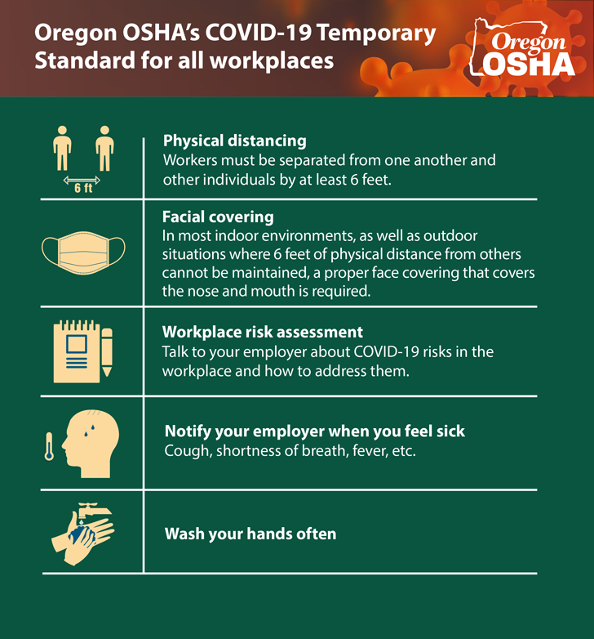
Masks, Face Coverings, and Face Shields
Oregon OSHA requires everyone at the workplace or in other areas that are under the employer’s control (including employees, part-time workers, temporary laborers, customers, vendors, patrons, contractors, etc.) to wear a mask, face covering, or face shield following the requirements of the Oregon Health Authority’s Statewide Mask, Face Covering, Face Shield Guidance. These source control items are required to be provided by the employer to workers at no cost. It is strongly recommended, but not required, that people wear a mask or face covering as source control rather than relying upon a face shield alone.
Module 3: control measures

Slide 28
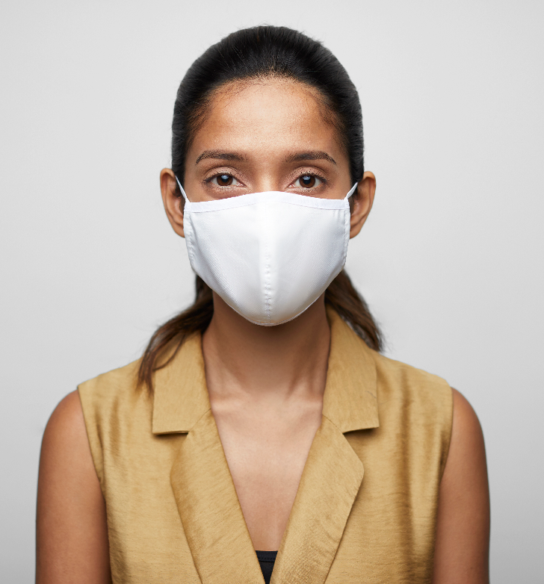
Face Coverings Definition
Please note that masks and face coverings are not the same thing, as each have separate definitions. Let’s start with face coverings:
“A cloth, polypropylene, paper or other covering that covers the nose and the mouth and that rests snugly above the nose, below the mouth, and on the sides of the face. Coverings that incorporate a valve that is designed to facilitate easy exhalation or mesh masks or other covers with openings, holes, visible gaps in the design or material, or vents are not appropriate face coverings (even if otherwise appropriate for respiratory protection) because they allow droplets to be released from the covering.”
Module 3: control measures

Slide 29
Mask Definition
Oregon OSHA defines mask as:
“A U.S. Food and Drug Administration (FDA) cleared surgical, medical procedure, dental, or isolation mask (commonly referred to as a “surgical mask”). Masks are medical grade masks that function as a physical barrier to protect workers from hazards such as splashes of large droplets of blood or bodily fluids; they do not provide reliable protection to the wearer against aerosols or airborne pathogens.”
Module 3: control measures

Slide 30
Module 2: signs, symptoms, and transmission

Slide 31
Face Shield Definition
Oregon OSHA defines face shields as:
“Transparent plastic shield that covers the wearer’s forehead, extends below the chin, and wraps around the sides of the face. Devices that place a shield in front of only the user’s nose and mouth do not meet the definition of a mask, face covering, or face shield. Face shields are normally used as protection for the face and eyes but are a compliant (although not preferred) means of “source control” in relation to COVID-19.”
Module 3: control measures

Slide 32
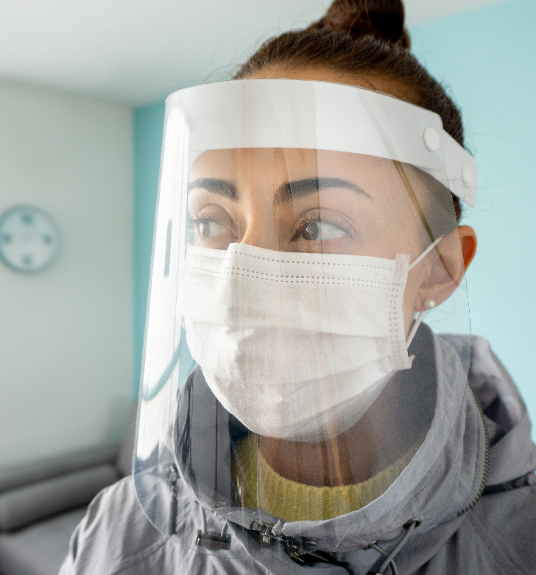
Face Shield Warning
While on this topic, let’s talk about face shields. Although face shields are normally used to protect the eyes, the rule allows them to be used as source control. However, their use should be minimized and generally limited to those who cannot wear a mask or face covering. The reason is that masks and most face coverings are more effective at source control. Unlike a mask or face covering, a face shield does not prevent or reduce droplets from being released into the surrounding area. Please refer to the Oregon Health Authority for current information.
Module 3: control measures

Slide 33
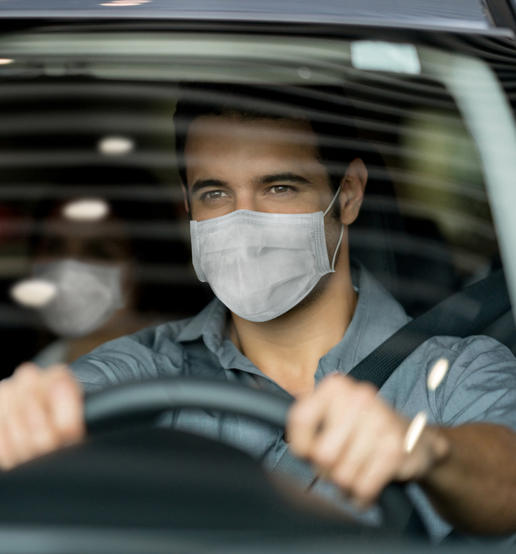
Transportation
When employees are transported in a vehicle for work purposes, regardless of the travel distance or duration involved, everyone in the vehicle must wear a mask, face covering, or face shield unless employees are wearing respirators in accordance with the Respiratory Protection Standard (29 CFR 1910.134). This rule doesn’t apply when everyone in the vehicle are members of the same household.
Module 3: control measures

Slide 34
Cleaning Requirements
Employers are required to make sure that all common areas, shared equipment, and high-touch surfaces are cleaned regularly. The term “high-touch area” refers to equipment or surfaces that are handled frequently throughout the day by multiple individuals. A few examples include countertops, credit card terminals, doorknobs, digital kiosks, touch-screen enabled devices, light switches, handrails, elevator control panels, and steering wheels. Please take a moment to learn more about cleaning here.
Module 3: control measures

Slide 35
Cleaning Schedule
How often do you need to clean? It will depend on how the workplace is occupied; there are 2 categories:
At least once every 24 hours if the workplace is occupied less than 12 hours a day; or
At least every 8 hours while in use, if the workplace is occupied more than 12 hours a day.
Exception: In locations with only “drop-in” availability or minimal staffing, you can use a regular schedule of cleaning and sanitation and direct employees to sanitize their own work surfaces before use. An example of this type of situation would be an employee that stops by the office over the weekend to work for an hour.
Module 3: control measures

Slide 36
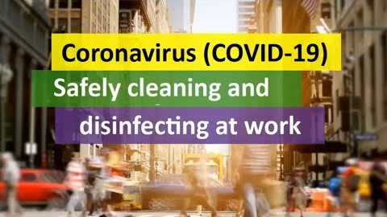
Module 3: control measures

Slide 37
COVID-19 Infection Cleaning Protocol
Employers must clean and disinfect any common areas, high-touch-surfaces, and any shared equipment under the employer’s control that an individual known to be infected with COVID-19 used or had direct physical contact with. This requirement does not apply to areas, surfaces, or equipment that has been unoccupied or otherwise unused for seven days or more. As a
recommendation, but not a required practice, employers should close off the area and observe a waiting period of at least 24 hours (or for as long as is feasible) prior to cleaning and disinfecting.
Module 3: control measures

Slide 38
Hand Hygiene
We would like to take a moment to emphasize the importance of proper handwashing. This means cleaning or sanitizing your hands using standard hand washing methods, with soap and running water, or alcohol based hand sanitizer. Do this frequently, especially before eating or entering your facility and after using a high touch surface. In the next slide, we’ll watch a short silent video explaining proper handwashing.
Module 3: control measures

Slide 39
Module 3: control measures

Slide 40
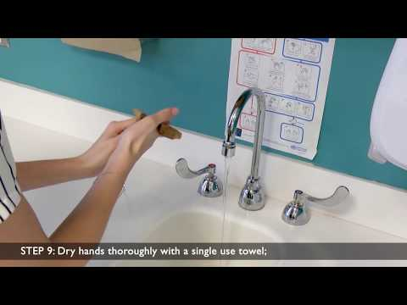
Module 3: control measures

Slide 41
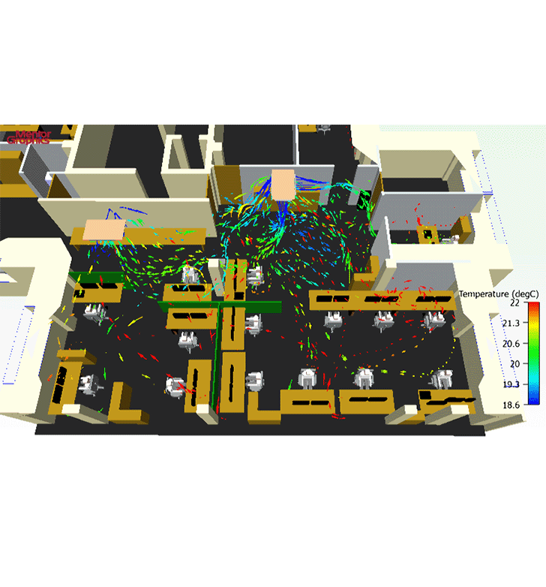
Ventilation
Take a moment to consider the hazards of airborne transmission of COVID-19. The image on the right depicts how air flows through a typical office space. According to the EPA (Environmental Protection Agency), COVID-19 may spread via airborne particles in indoor environments beyond the 6 feet required by physical distancing. Fortunately, there are straightforward steps that can be taken to reduce potential airborne transmission of COVID-19. The layout and design of a building, as well as occupancy and type of heating, ventilation, and air conditioning (HVAC) system can all impact the airborne spread of the virus. In the next few slides, we’re going to focus on the requirements for HVAC systems.
Module 3: control measures

Slide 42
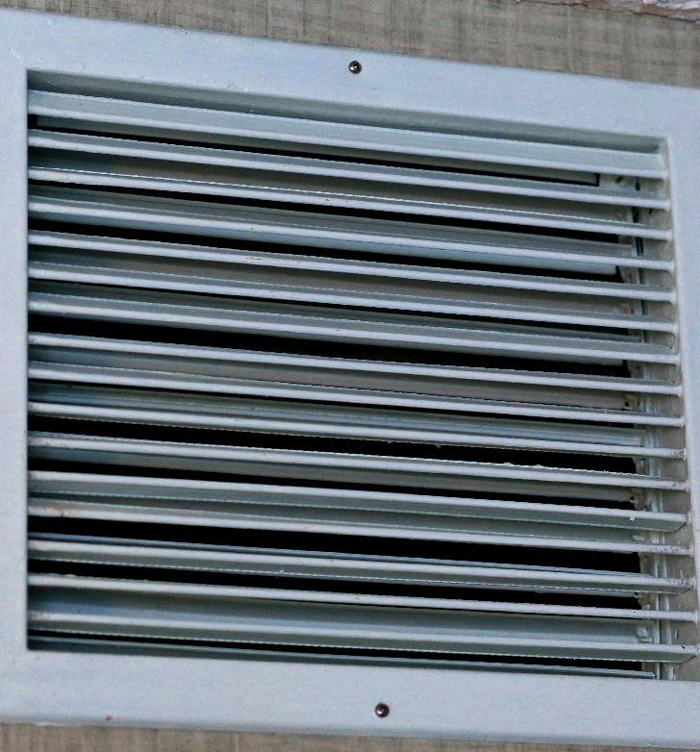
Ventilation Requirements for Employers
No later than January 6, 2021, the employer must optimize the amount of outside air circulated through its existing heating, ventilation, and air conditioning (HVAC) system(s) whenever there are employees in the workplace and the outdoor air quality index remains at either “good” or “moderate” levels. This does not require installation of new ventilation equipment. The employer is not required to meet the provisions of the American National Standards (ANSI) / American Society of Heating, Refrigerating and Air-Conditioning Engineers (ASHRAE) Standards 62.1 and 62.2 (SHRAE 2019a, 2019b), but to the degree the employer does so it is in compliance with this paragraph.
Module 3: control measures

Slide 43
HVAC Maintenance
In accordance with the manufacturer’s instructions and the design specifics of the HVAC system, and as frequently as is necessary, the employer must ensure the following:
All air filters are maintained and replaced as necessary to ensure the proper function of the ventilation system; and
All intake ports that provide outside air to the HVAC system are cleaned, maintained, and cleared of any debris that may affect the function and performance of the ventilation system.
Module 3: control measures

Slide 44
Key Takeaways
You’ve completed module 3! The safe work practices and control measures discussed in this section are just the basics, there’s so much more to learn! As we previously mentioned, each workplace is unique and will present its own challenges in your safety and health journey. In any workplace situation you may find yourself in, always apply the basic principle of standard precautions - treat everyone as if they are infected and contagious with COVID-19, even if they are feeling well.
You’re almost finished with the course! There is just one more module to complete.
Module 3: control measures

Slide 45
COVID-19 Training Requirements
Module 4: Conclusion

Slide 46
Final Module Overview
Welcome to module 4! We’ve covered a lot of information about COVID-19 and the control measures that are available to reduce your exposure. In this final module, we’ll cover a few additional training topics from the rule. Let’s get started!
Module 4: conclusion

Slide 47
Training Elements
Oregon OSHA requires employers to provide COVID-19 training to their employees. This training consists of 10 elements. In this course, you’ve already covered 4 of these elements. Your employers must provide training on the remaining 6 elements:
Physical distancing requirements as they apply to the employee’s workplace and job function(s);
Mask, face covering, or face shield requirements as they apply to the employee’s workplace and job function(s);
COVID-19 sanitation requirements as they apply to the employee’s workplace and job function(s);
COVID-19 signs and symptom reporting procedures that apply to the employee’s workplace;
COVID-19 infection notification process; and
Medical removal as required by the rule.
In the next few slides, let’s take a look at the last two items in the list.
Module 4: conclusion

Slide 48
COVID-19 Infection Notification
Employers must establish a process to notify affected employees that they had a work-related contact with someone who has tested positive for COVID-19. The COVID-19 infection notification process must include the following elements:
A mechanism for notifying affected employees within 24 hours of the employer being made aware that someone with COVID-19 was present in the workplace while infectious or otherwise may have had work-related contact with its employee(s) while infectious; and
This notification process must be established and implemented in accordance with all applicable federal and Oregon laws and regulations.
Module 4: conclusion

Slide 49
COVID-19 Medical Removal
Whenever the Oregon Health Authority, local public health agency, or medical provider recommends an employee be restricted from work due to quarantine or isolation for COVID-19, such as through identification during contact tracing activities, the affected worker(s) must be directed to isolate at home and away from other non-quarantined individuals.
Module 4: conclusion

Slide 50
COVID-19 Medical Removal Notes
Employees restricted from work due to medical removal must be allowed to work from home if suitable work is available and they feel well enough to do so. An employee participating in quarantine or isolation is entitled to return to their previous job duties. The key point here is that no adverse action can occur as a result of participation in quarantine or isolation activities.
Returning to work after quarantine or isolation needs to be made following applicable public health, or a medical provider’s guidance. Please note that a negative COVID-19 test is not required.
Module 4: conclusion

Slide 51
Module 4: conclusion

