Slide 1


Sweet Home WWTP Improvements Project
60% Update
August 2020

Slide 2
Project Foundation
“…make decisions that do the most good, for the most people, for the longest period of time”
Source: 2017-18 City Council Goals

Slide 3
Agenda
1
2
3
4
5
Introductions
Project History
60% Design
Update
Schedule and Next Steps
Questions

Slide 4
Introductions

Slide 5
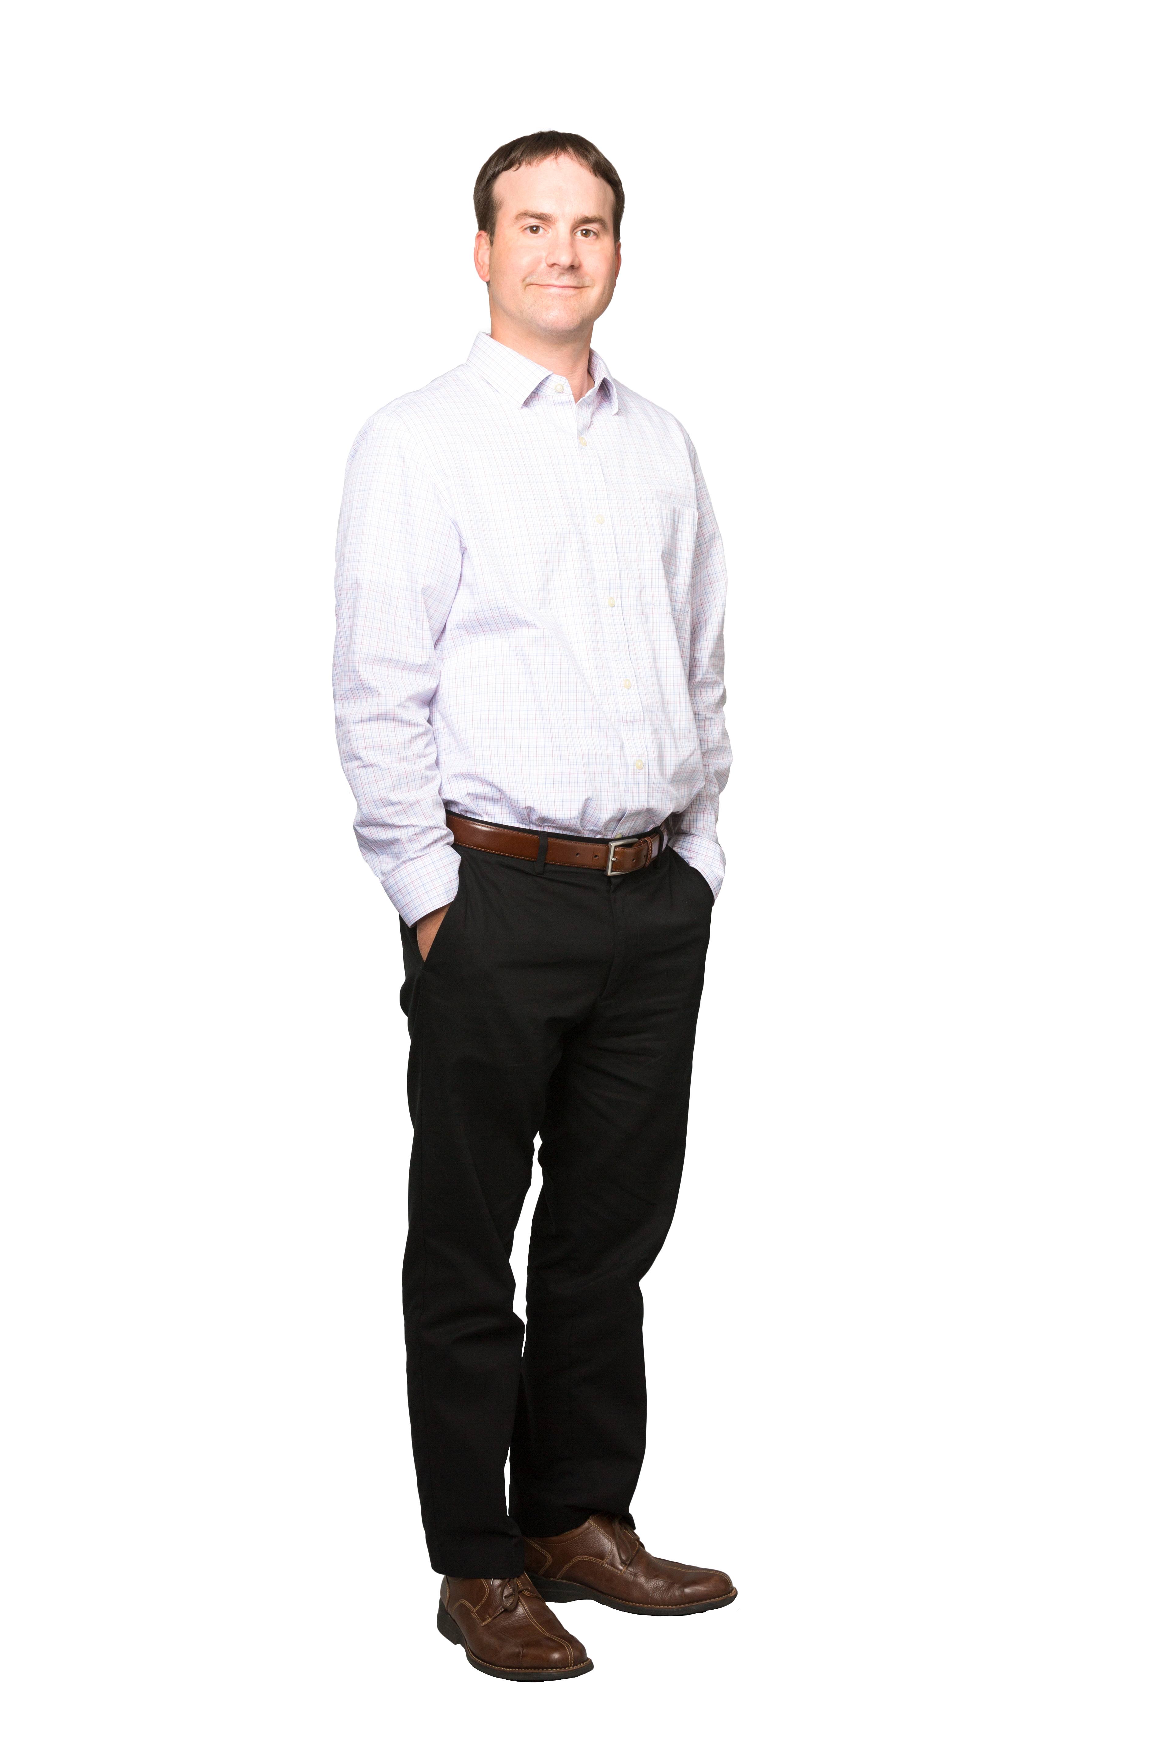
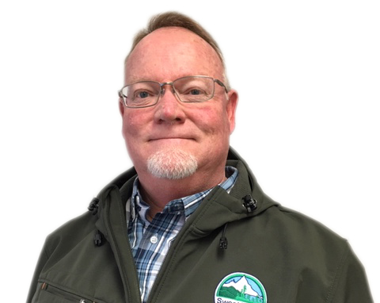
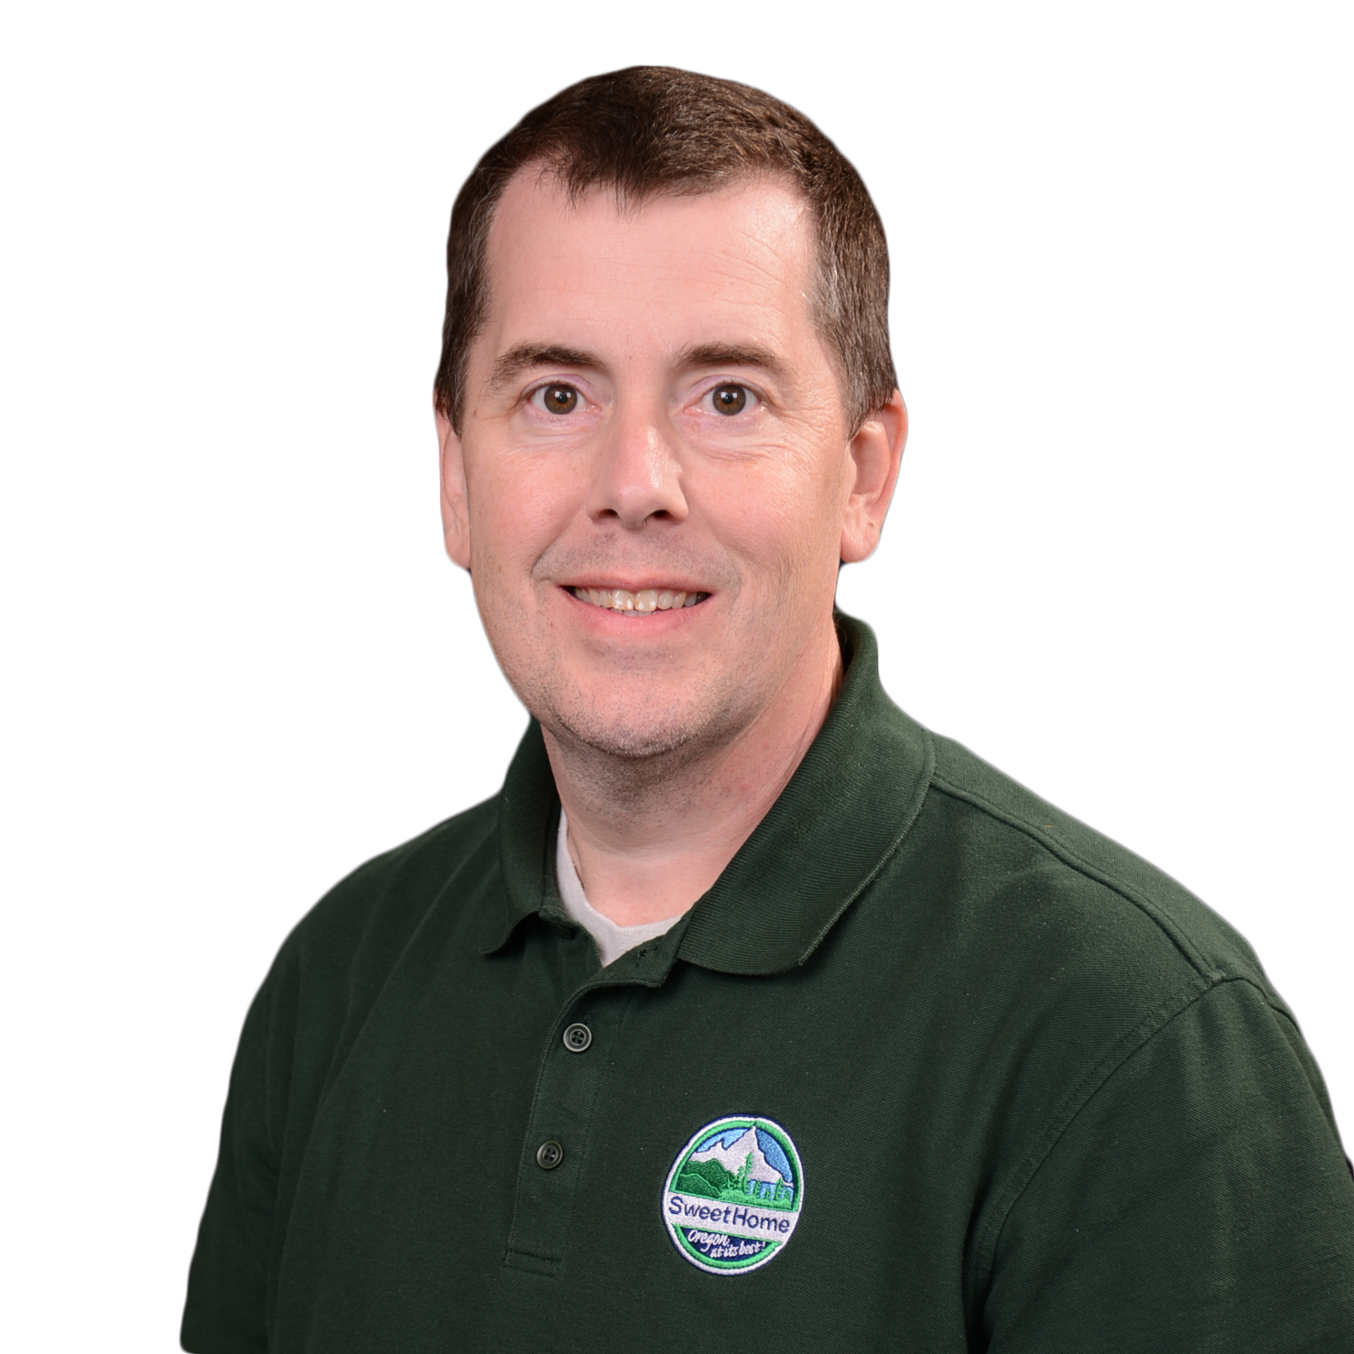
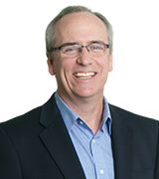

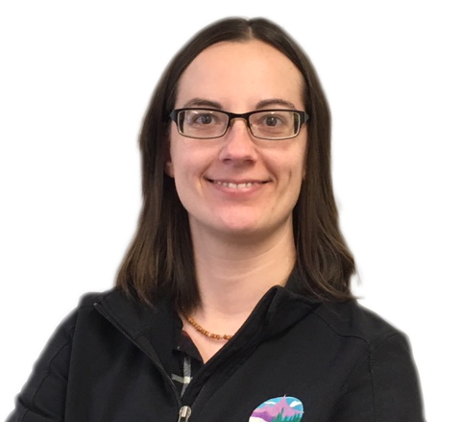


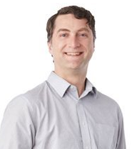
Team Introductions
Greg Springman
Public Works Director
Steven Haney
Utility Manager
Tom Perry, PE
Principal-in-Charge
Austin Rambin, PE
Project Manager
Miaomiao Zhang, PE
Design Manager
Patrick Davis, EIT
Staff Engineer
Jessica Cawley, PE
Staff Engineer
Justin Moman, PE
Staff Engineer
Trish Rice
Engineering Technician
CITY
MURRAYSMITH

Slide 6
Project History

Slide 7
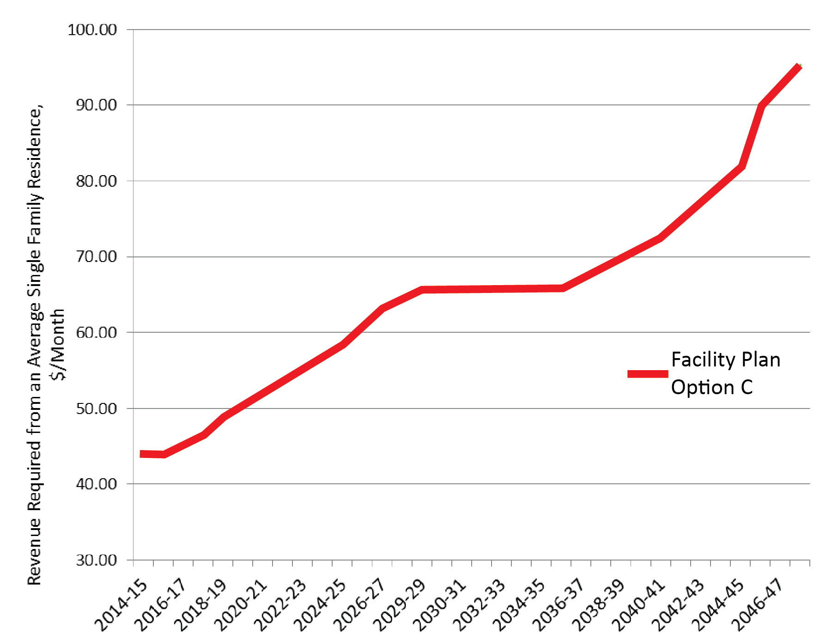
Original Facilities Plan Review
Future Rates: ~$95/month
Original Recommended Plan:
$42 Million over 30 years
Separate Peak Flow Process
Limited Rehabilitation

Slide 8
Continued Collection System Focus
Req’d WWTP Capacity: 12 MGD
Peak hour flows do not account for future population growth or expansion of the City’s service area
Existing WWTP Capacity: 7 MGD

Slide 9
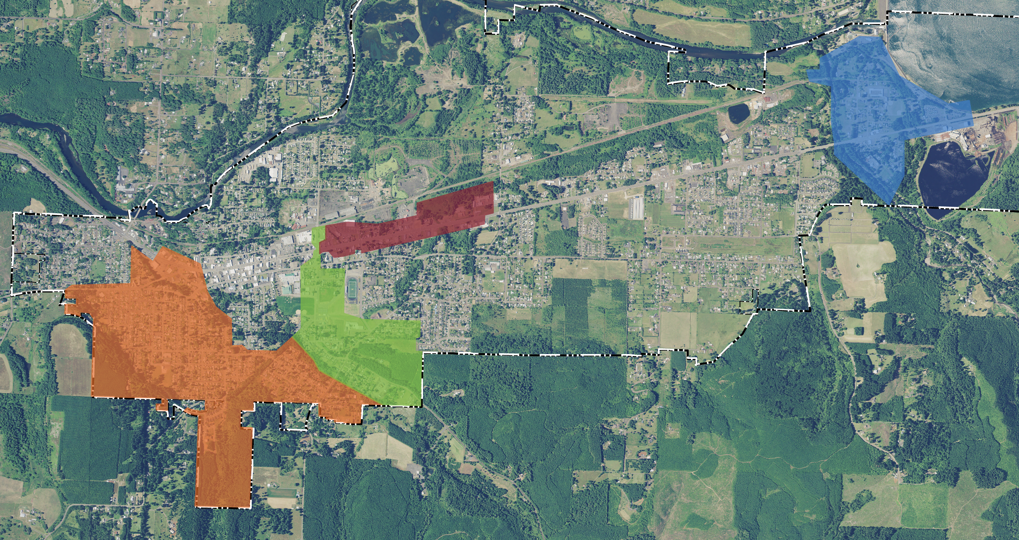
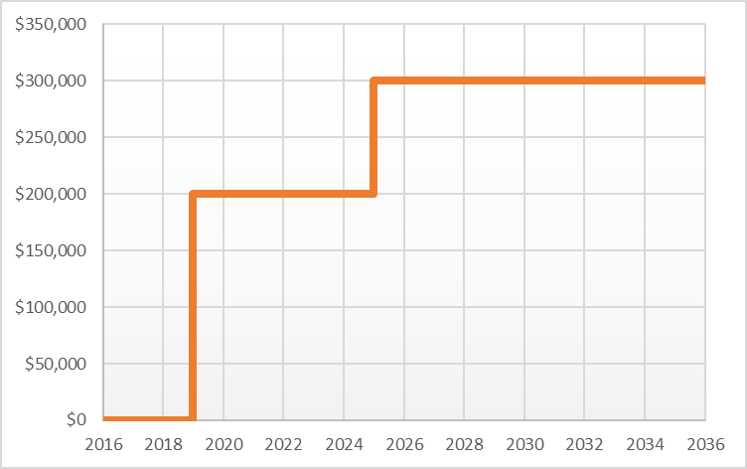
Continued Collection System Focus
Allow for future growth
Address aging collection system
Maintain WWTP Flow < 12 MGD
$3 - 6M of targeted collection system rehabilitation:
  Remove ~2 MGD of RDII over next 20 years
  To be completed in-house by City staff
  City working on manhole sealing now

Slide 10
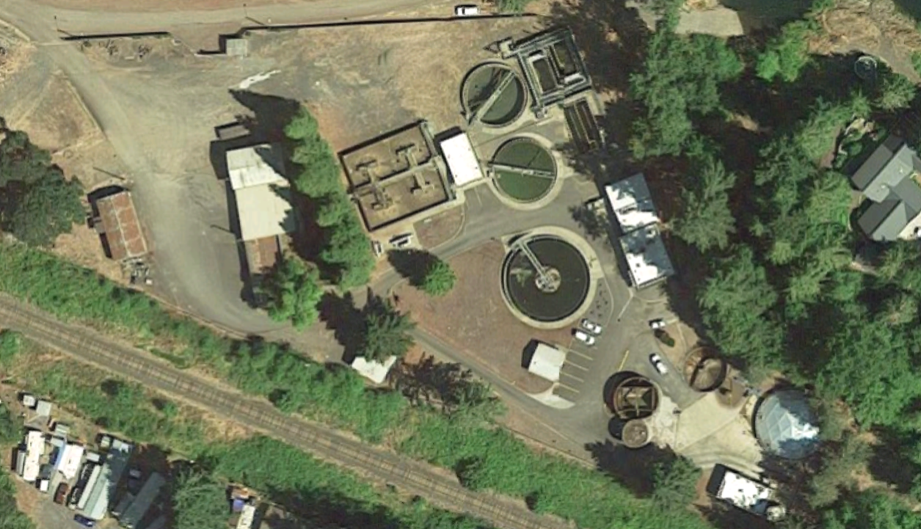
Existing WWTP Review
Upper Plant – Expansion Area
Lower Plant – Existing Facility Area

Slide 11
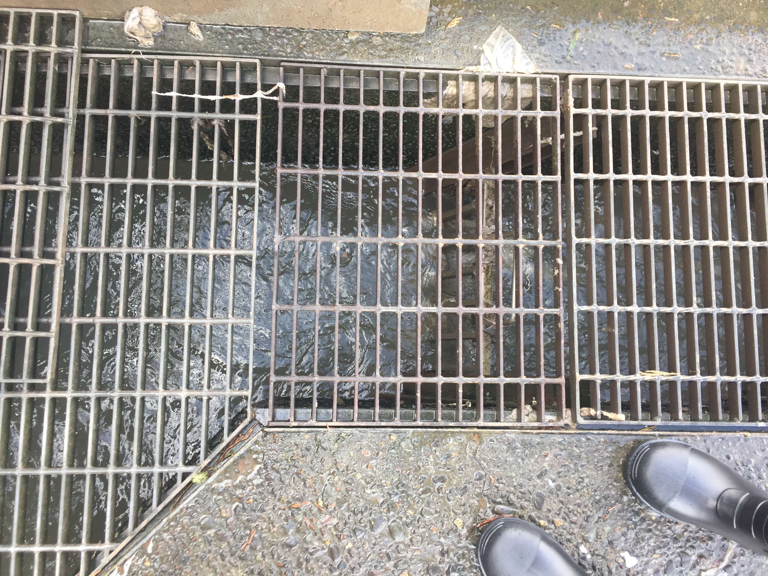
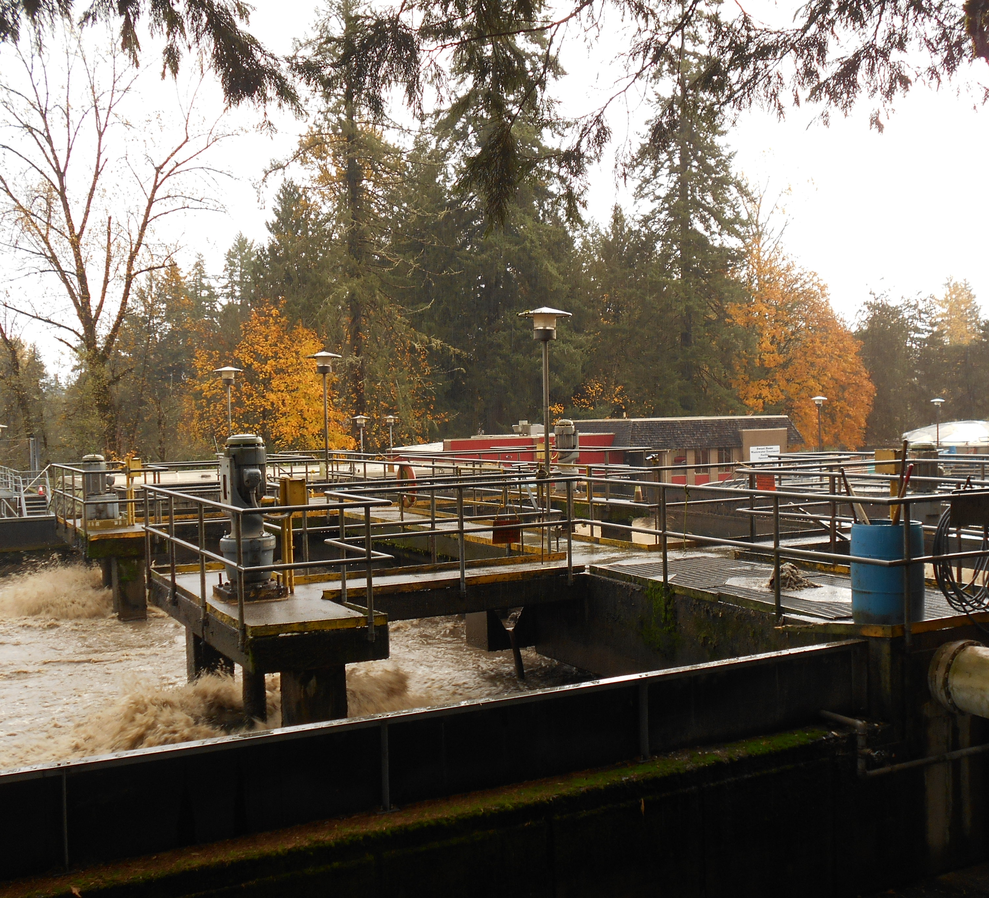
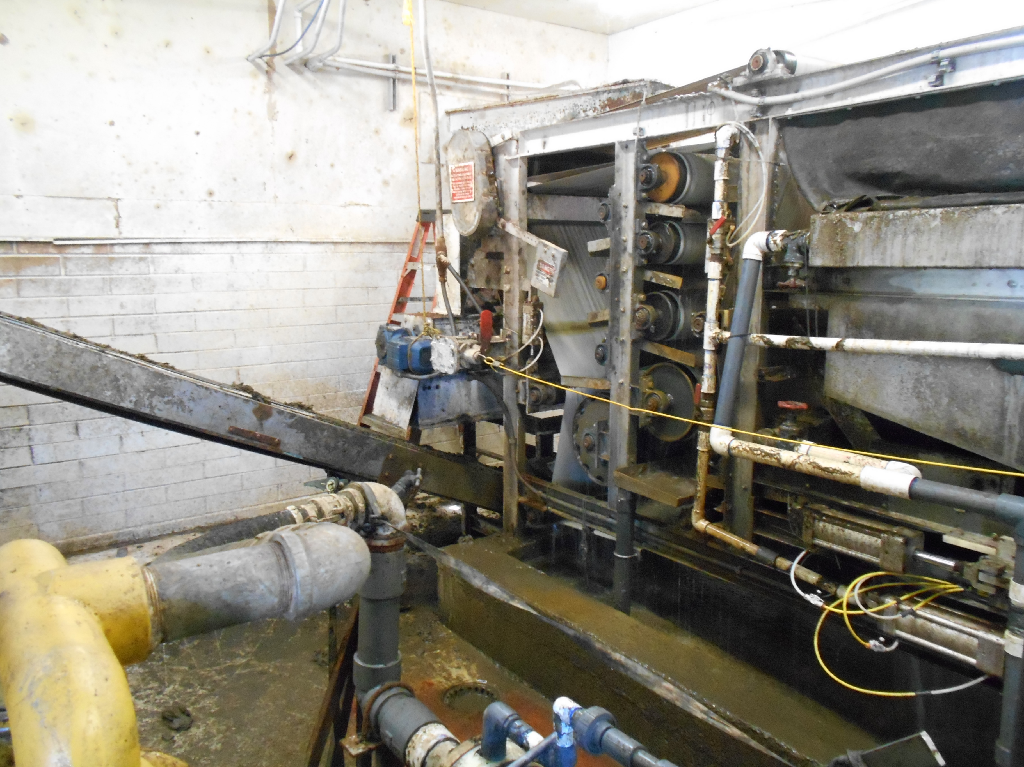
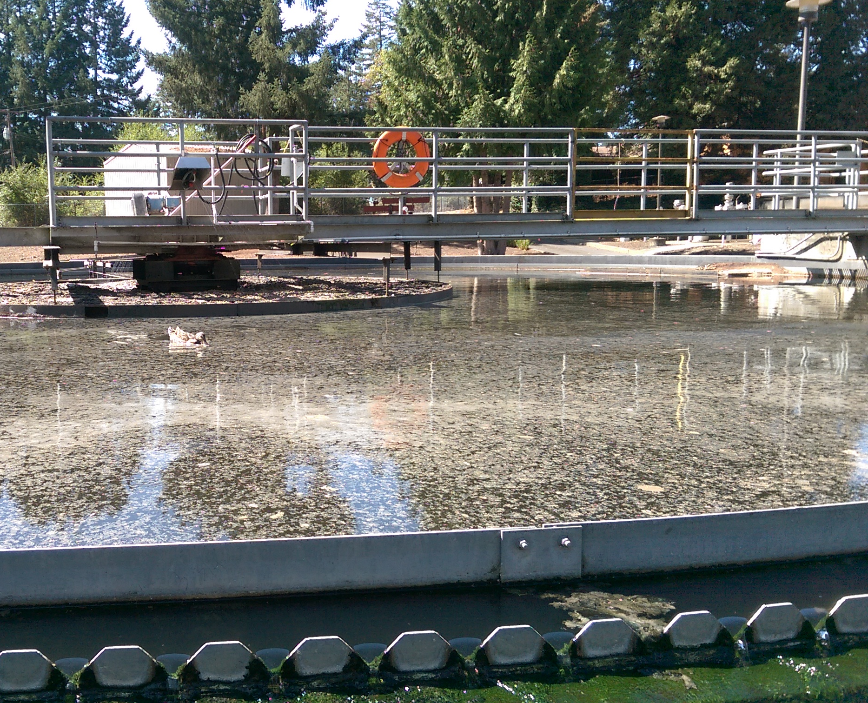
Existing WWTP Challenges
Secondary only, complete mix process
No Headworks (rags everywhere)
Early 1990’s upgrade added tertiary sand filters
Undersized CCB
Inadequate Aerated Sludge Storage Basin
Dewatering Facility with significant code violations
Limited SCADA/automation
Multiple DEQ fines for permit violations in past few years

Slide 12
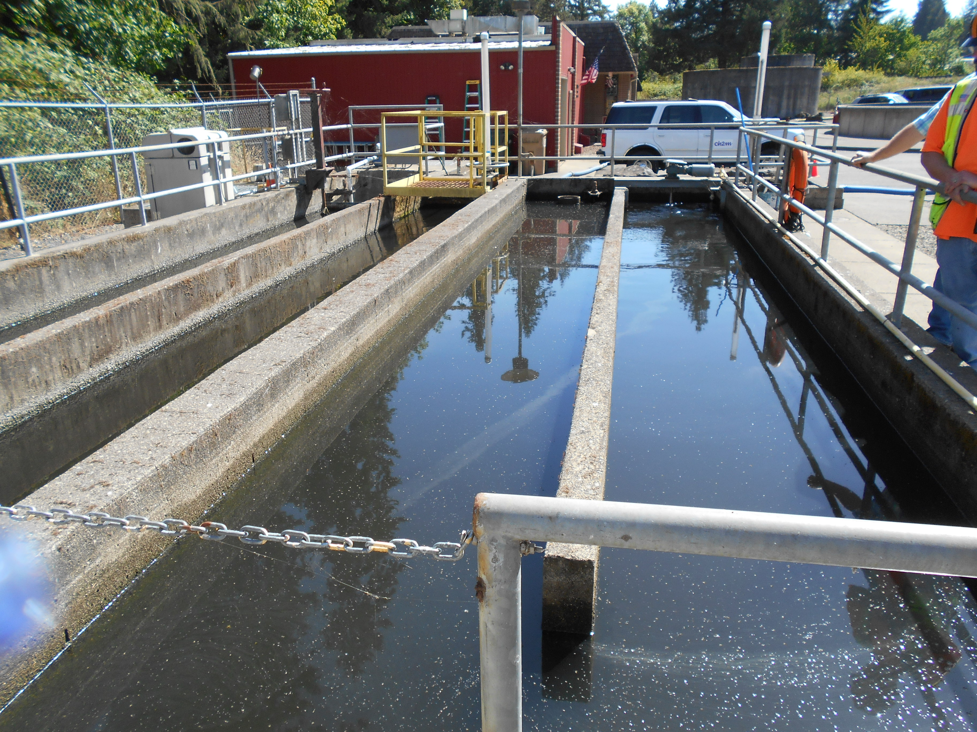
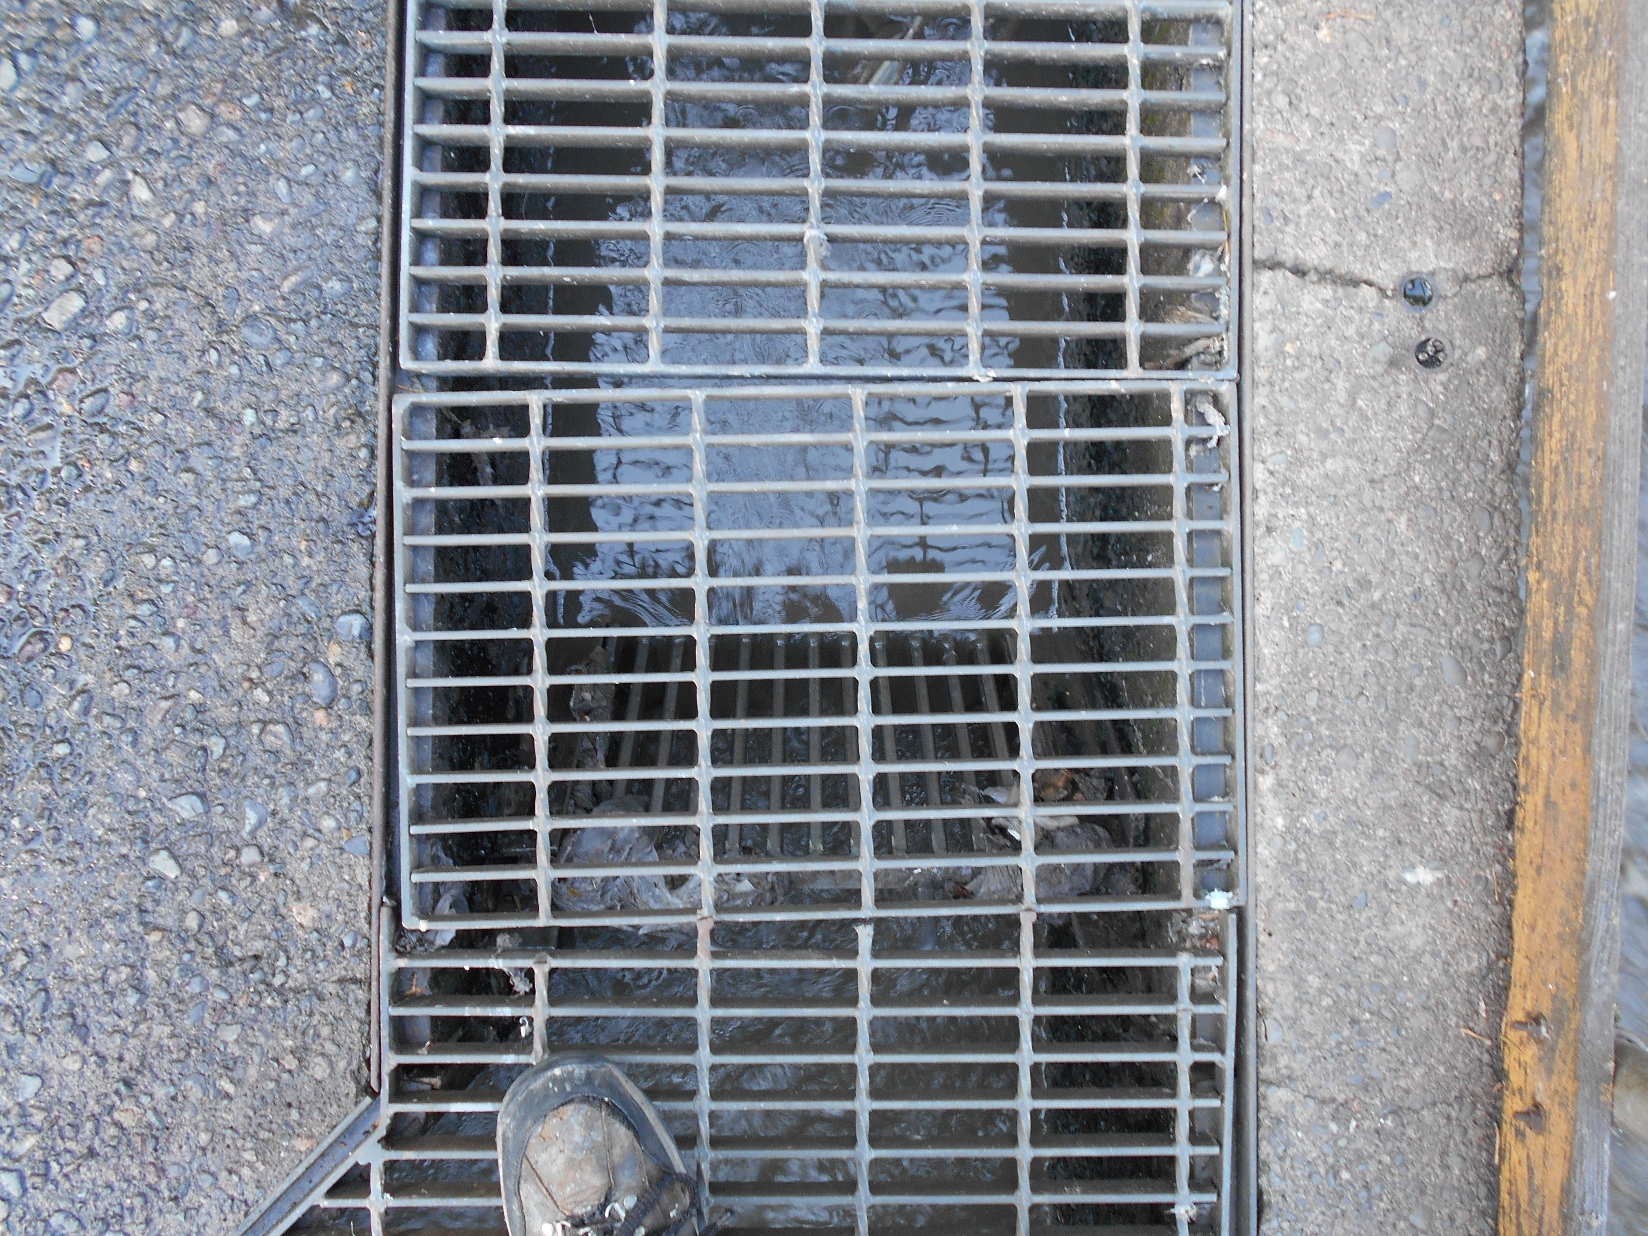
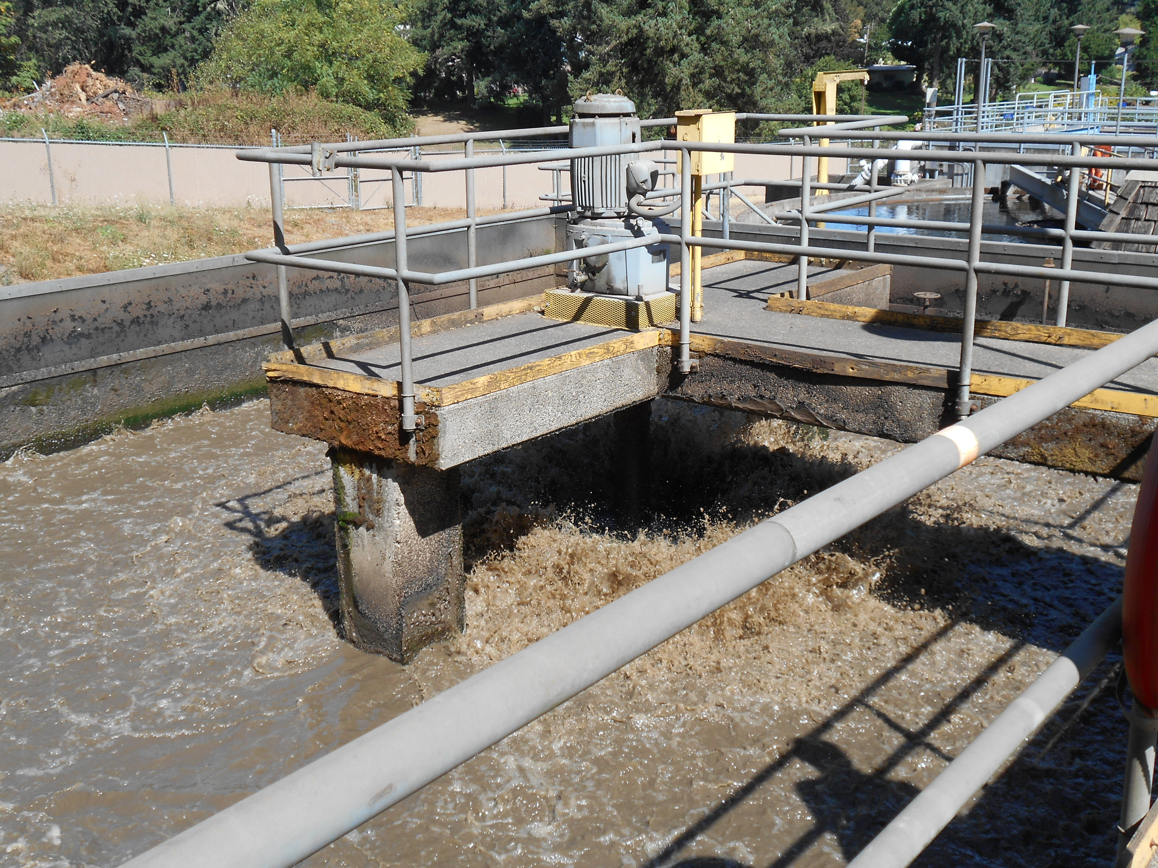

“3R” Asset Management Approach
Rehabilitate existing structures
Reuse existing assets
Re-purpose existing processes/areas

Slide 13
Rehabilitation @ Half the Cost of New Construction – if done timely!
Rehabilitation MORE cost-effective
Rehabilitation LESS cost-effective

Slide 14
Targeted Avg. Monthly Wastewater Rate
~$30/month lower

Slide 15
60% Design
Update
Sweet Home WWTP

Slide 16
Project Status Update
Key Milestones
  60% Review Period – now
  90% Design Development – this fall
  100% Design Development and Regulatory Review – early 2021
  Bidding – Summer 2021
  Construction – Summer 2021 to Fall 2023
Funding
  Required VE Study – RFP soon
  USDA & DEQ – application process now
  USDA PER/ER review to follow complete application submission
Permitting
  Anti-degradation Evaluation for Mass Load Increase
  Working to get NPDES Permit Renewal expedited with DEQ

Slide 17
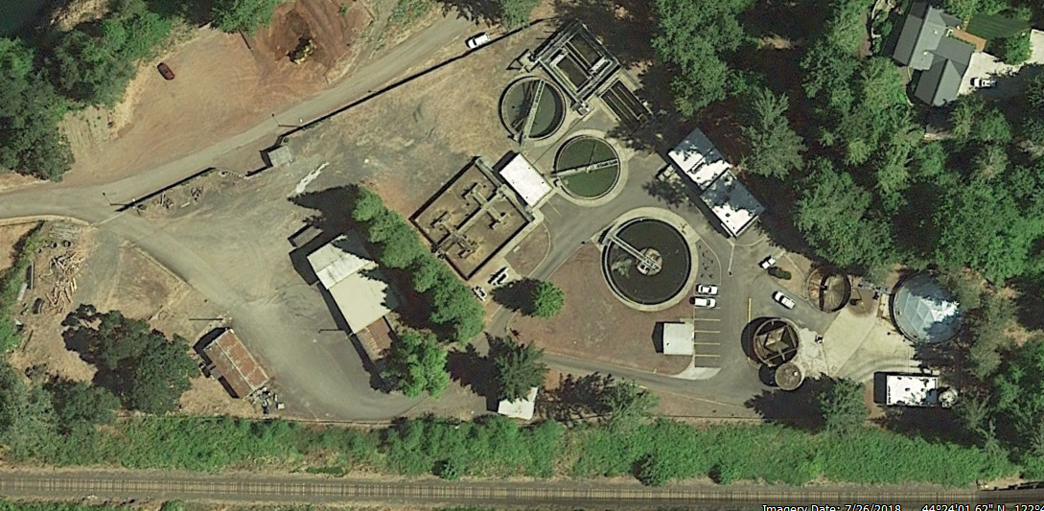
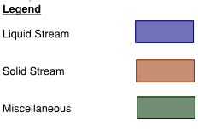
WWTP 60% Site Plan
Primary Sludge PS
N. Elec Room
ML Flow Split
Drying Beds
Secondary Clarifier 1
UV and Utility Water
Secondary Clarifier 2
Filter Basin
Primary Clarifier
Blower Building
Aeration Basin
Thickening Building
Secondary Clarifier 3
Administration Building
RAS/WAS Pump Station
Primary Flow Split
Headworks Building
Primary Digester
Secondary Digester
Dewatering Building and Cake Storage
Secondary Clarifier
4
Solids Building
Workshop and Storage Building
S. Elec Room
IPS/DPS

Slide 18
60% Design – “3R” Elements
“3R” Elements:
Influent Pump Station
Aeration Basin Expansion
Secondary Clarifiers
Chlorine Contact Chamber
Aerobic Digester
South Electrical Room
Primary Sludge PS
N. Elec Room
ML Flow Split
Drying Beds
Secondary Clarifier 1
UV and Utility Water
Secondary Clarifier 2
Filter Basin
Primary Clarifier
Blower Building
Aeration Basin
Thickening Building
Secondary Clarifier 3
Administration Building
RAS/WAS Pump Station
Primary Flow Split
Headworks Building
Primary Digester
Secondary Digester
Dewatering Building and Cake Storage
Secondary Clarifier
4
Solids Building
Workshop and Storage Building
S. Elec Room
IPS/DPS

Slide 19
Site Flyover
Forthcoming

Slide 20
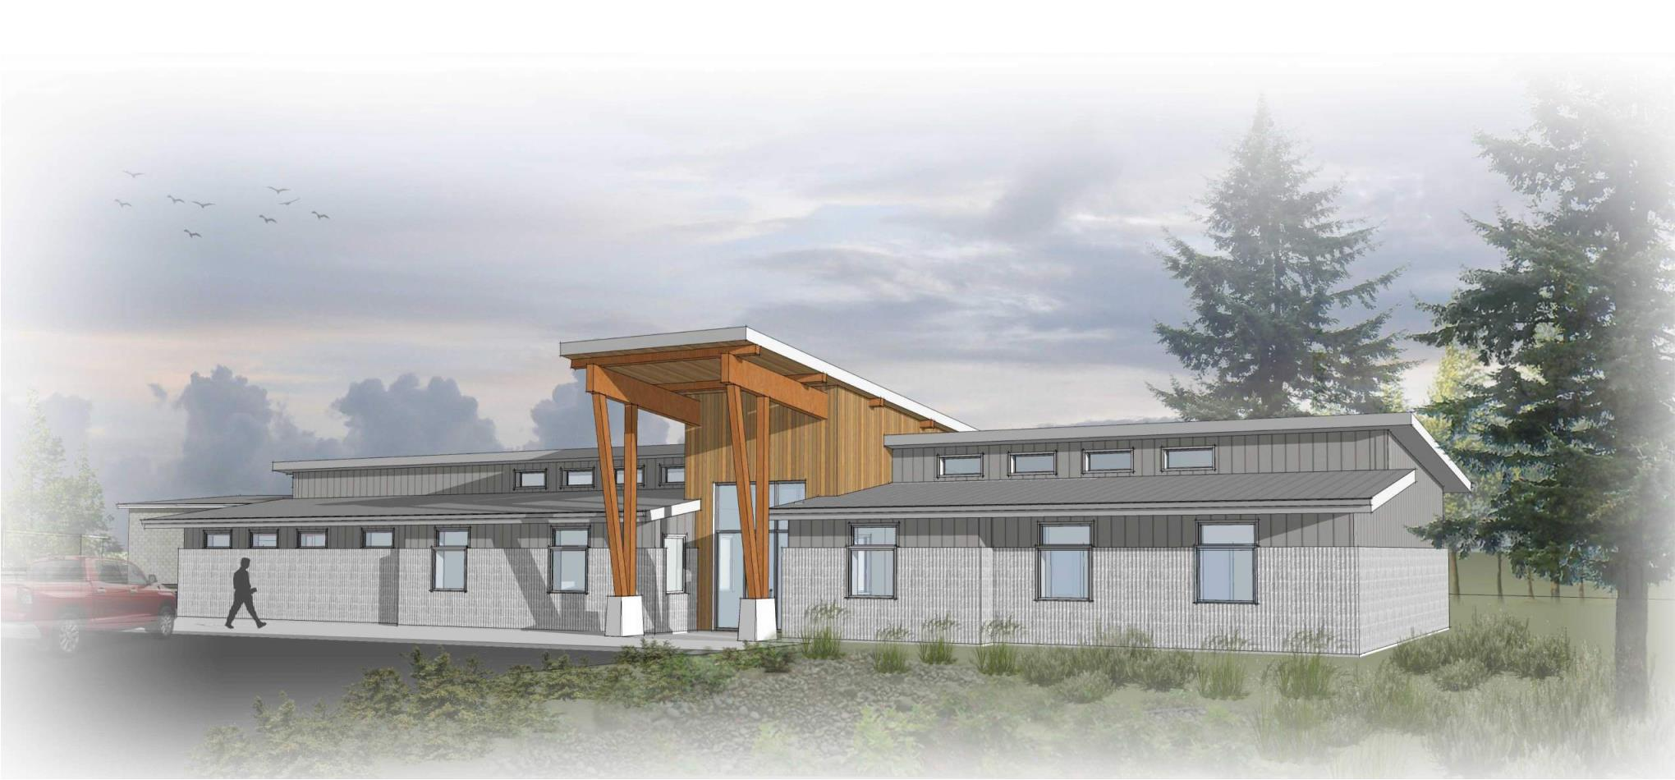
Administration Building

Slide 21
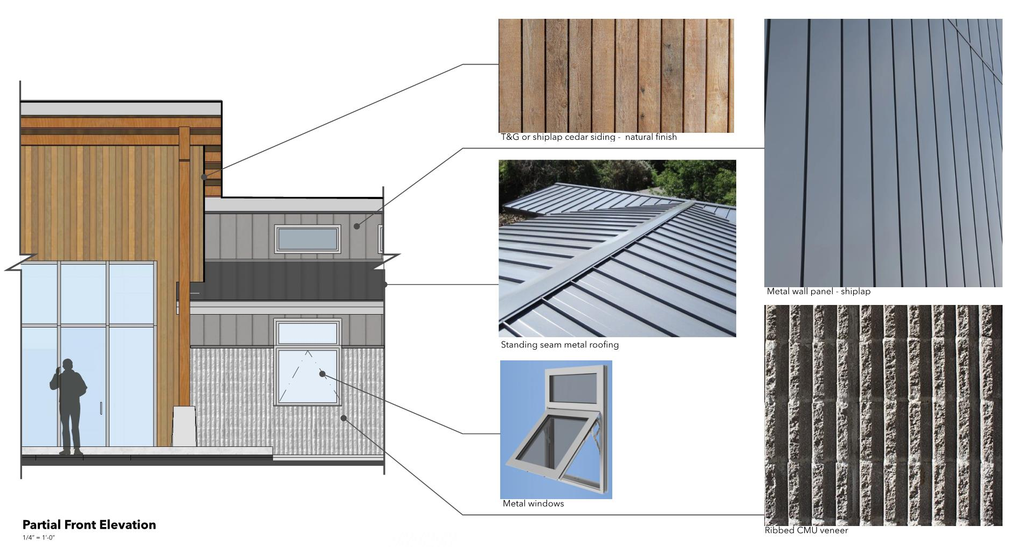
Administration Building

Slide 22
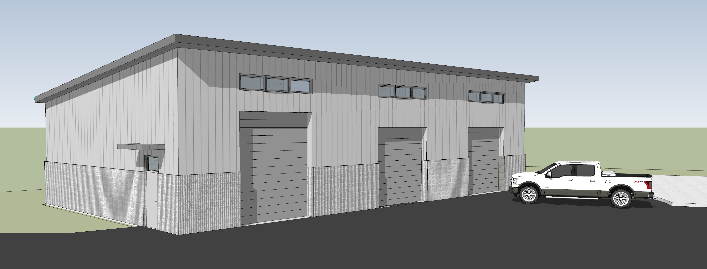
Maintenance Building
Service bay for vehicle storage and maintenance
Shop for in-house equipment maintenance
Storage space for spare parts and records

Slide 23
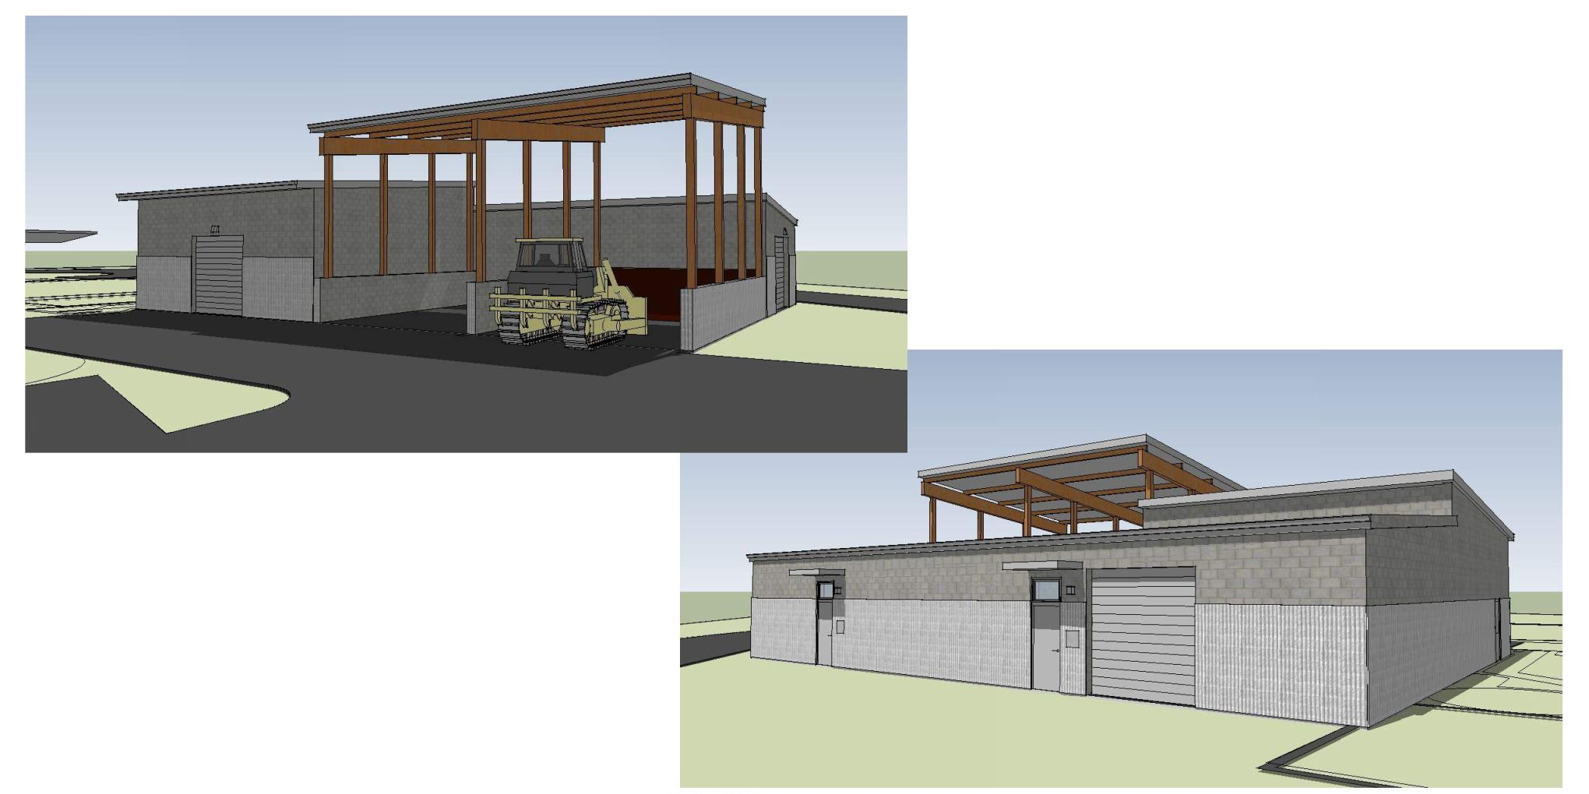
Headworks, Dewatering & Cake Storage
Three processes combined
Protects downstream mechanical equipment
Reduces volume of biosolids
Storage for biosolids prior to disposal

Slide 24
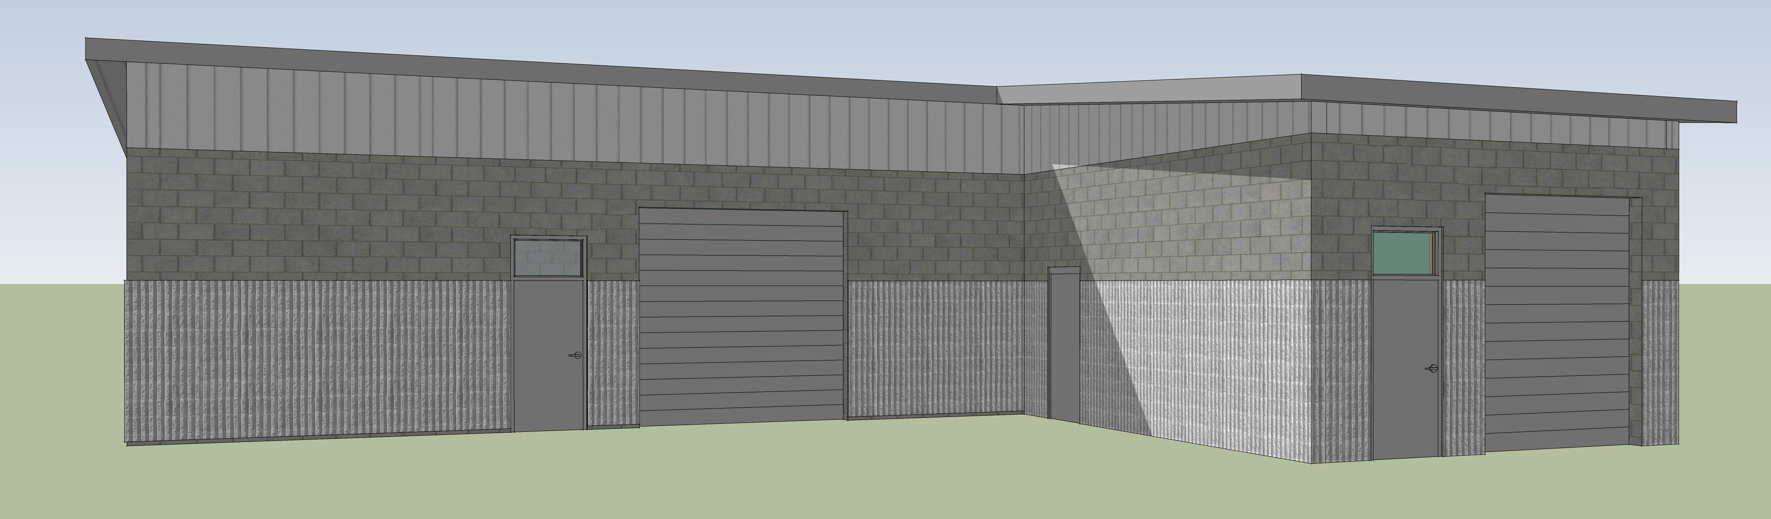
Process Building
Primary Sludge Pump Station, Blower Room, & North Electrical Room
Removes solids from liquid stream
Houses equipment critical for biological treatment process
Stores electrical equipment at ideal environmental conditions

Slide 25
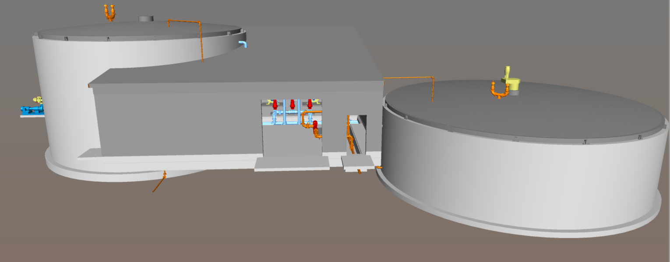
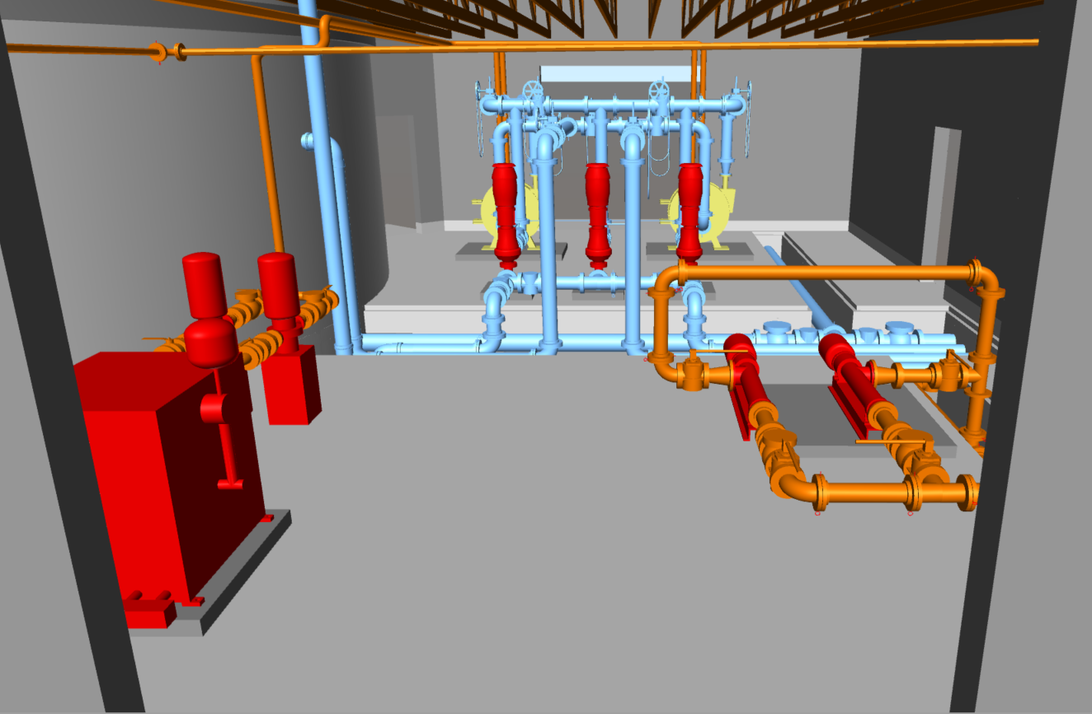
Digester Complex
Solids stream treatment
Primary & Secondary Digesters
Building in center for equipment

Slide 26
Cost Update
 | 20% Schematic Design⁽¹⁾ | 60% Design Development⁽²⁾
Influent Pump Station | $2,100,000 | $1,600,000
Headworks Screening and Grit Removal | $2,900,000 | $3,200,000
Primary Clarifier | $1,700,000 | $2,100,000
Aeration Basin Modifications | $3,500,000 | $4,900,000
Secondary Clarifiers | $2,400,000 | $2,200,000
Tertiary Filter | $1,850,000 | $1,400,000
UV Disinfection | $1,300,000 | $1,500,000
Solids Thickening | $900,000 | $700,000
Solids Digestion | $3,100,000 | $3,400,000
Dewatering and Biosolids Storage | $1,300,000 | Included in Headworks
Civil Site Improvements | $1,500,000 | $2,200,000
New Administration/Lab Building | $1,250,000 | $1,800,000
New Maintenance Building | - | $1,000,000
Offsite Class A Biosolids Composting Facility | $1,600,000 | $1,600,000
Electrical and Instrumentation | $2,800,000 | $2,500,000
Total OPPC | $28.2 M | $30.1 M
Costs include markups for General Conditions (8%), Mobilization (8%), Contractor O&P (12%), Contingency (30%), and Engineering, Legal, and Contract Administration (25%)
Costs include markups for General Conditions (8%), Mobilization (8%), Contractor O&P (12%), Contingency (20%), and negotiated Engineering, Legal, and Contract Administration fees

Slide 27
From Schematic Design to Now
Primary Clarifier Cover – Keeping Odors at Bay = Good Neighbor
Advanced Process Control Valves – More Efficient, Better Treatment
Thickening Building – Changing Materials and a Focused Approach
Drying Beds – Operator Flexibility and Breathing Room
Administration Building – Futureproofing Through Expanded Scope
Maintenance Building – Value Added with Improved Functionality
Subsurface Conditions – A Clearer Picture Beneath Our Feet

Slide 28
Providing for future WWTP expansion beyond 20 year planning horizon
Additional channel for additional influent screen in Headworks
Provide piping for future Primary Clarifier if needed
Providing for future Aeration Basin Capacity expansion
Provide for future filter capacity expansion
Provide additional office space in Admin Building
Primary Sludge PS
N. Elec Room
ML Flow Split
Drying Beds
Secondary Clarifier 1
UV and Utility Water
Secondary Clarifier 2
Filter Basin
Primary Clarifier
Blower Building
Aeration Basin
Thickening Building
Secondary Clarifier 3
Administration Building
RAS/WAS Pump Station
Primary Flow Split
Headworks Building
Primary Digester
Secondary Digester
Dewatering Building and Cake Storage
Secondary Clarifier
4
Solids Building
Workshop and Storage Building
S. Elec Room
IPS/DPS

Slide 29
Long Term O&M Considerations
“…make decisions that do the most good, for the most people, for the longest period of time”(2017-18 City Council Goals)
  “3R” Approach brings aging facility back to life for 40-50 years
  Full plant automation reduces staffing requirements and cost
  Upgrades provide for cost-effective expansion in future to address unforeseen challenges (e.g. NPDES Permit, Industrial Growth, etc.)
  High quality compost eliminates $130k/year in landfill costs and provides a valuable end product for use by the City and residents

Slide 30
Project Funding Update
City Funds. With WW rate increase, the City is building considerable reserves to support the project.
  Currently projecting ~$7M in local funds contribution
Earmark Funding. City is currently utilizing a $2M earmark from the Oregon State Legislature. Another $7M earmark was approved with Senate Bill 5723 a few weeks ago.
USDA Grant Discussions. Discussions with USDA indicate a grant of up to 25% of the unfunded balance may be available.
ETO Incentives. Currently working with the Energy Trust of Oregon to identify energy efficiency incentives for the project. $330k incentives for Primary Treatment and Aeration Basin blowers in final stages of approval.
Loans. Discussing interim loan funding using DEQ’s State Revolving Fund.

Slide 31
Schedule and Next Steps
Sweet Home WWTP

Slide 32
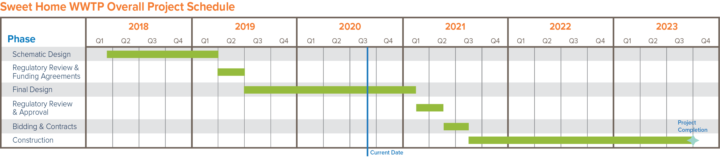
Overall Project Schedule

Slide 33
Next Steps
VE Study
Proceed with 90% Design Development
Continue coordination with Oregon DEQ on NPDES Permit
  Anti-degradation Evaluation for Mass Load Increase
  NPDES Permit Renewal
Continue work on project funding (USDA, DEQ, Business Oregon)

Slide 34

Questions?

